Slide 1
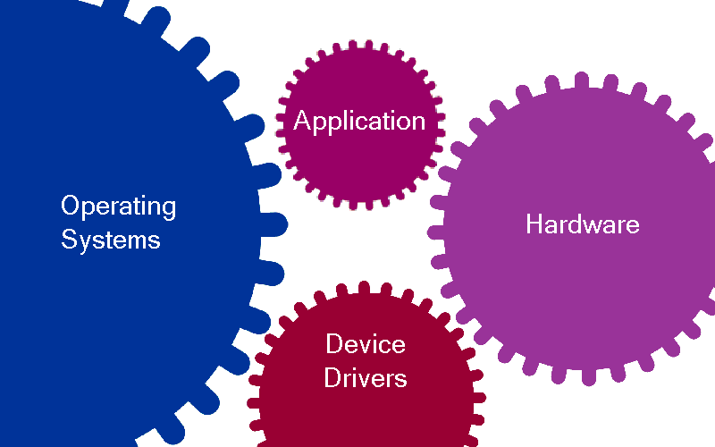
Challenges in Porting Embedded Applications
Presenter: Raj Johnson
Notes:
Application runs on a platform comprises of target OS, hardware & devices (as shown above)
Traditionally, development team puts in a lot of effort (time & money) into completely re-architecting the Application and platform components for next generation
The recent economic downturn, constantly changing platform environment and pressure to protect software investment challenges the engineers to seek alternatives to traditional development and take a serious look at porting and abstraction solution.
Engineers are now challenged to build components that are modular and abstracted from each other with an emphasis on leveraging on existing software
There is a strong push to develop cheaper products (reduced bill-of-material cost) with lower development cost. In order to accomplish this, engineers need to ensure that their software is not tied to a specific OS, hardware & devices

Slide 2
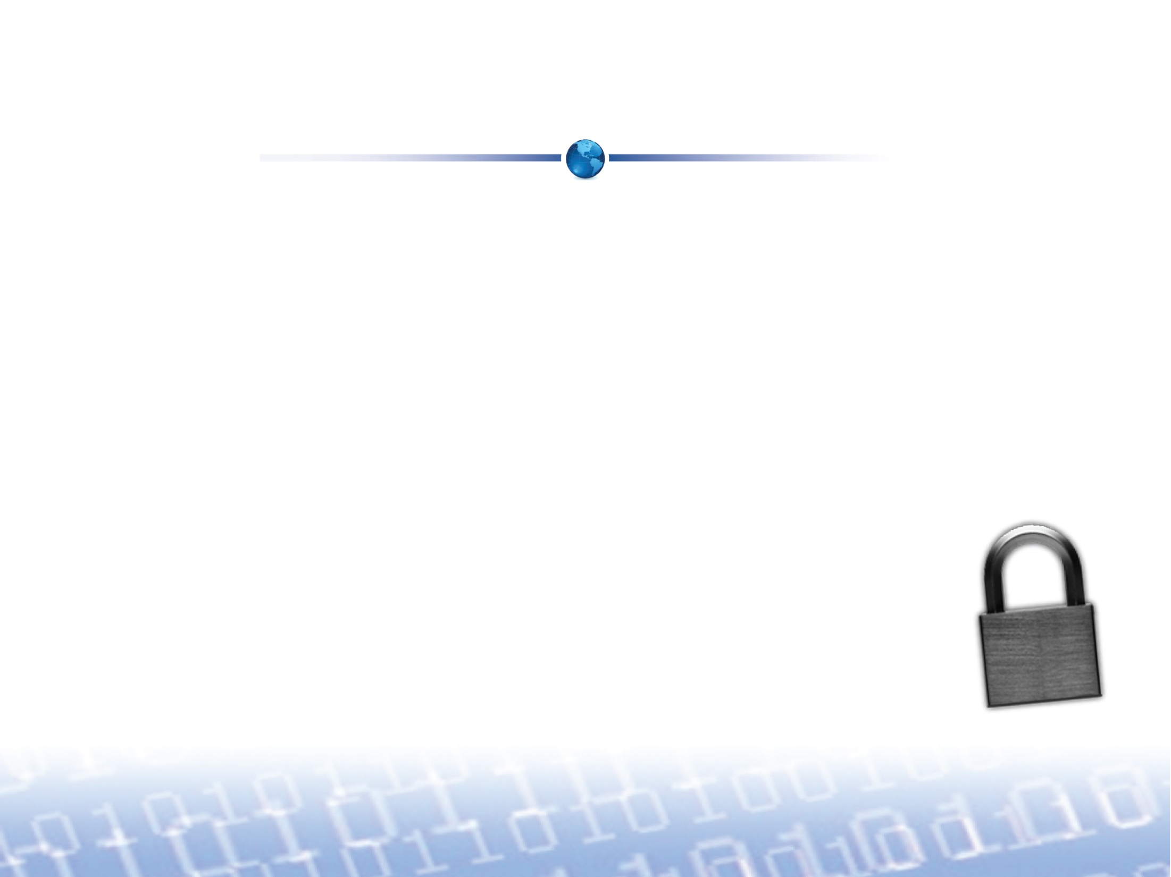

Getting Locked-In
Applications are developed with a particular platform in mind
  The software is locked to the current platform
  If a component of that platform changes, the application will no longer run without costly changes to the code due to variances in platforms
Reasons platforms change
  Changes in technical requirements
  Switching to more economical platforms
  Platform becomes obsolete
  Market & industry demands
Notes:
You are the full owner of your software. Unfortunately if your software can only work on a specific OS vendor’s platform, the vendor almost have a lien on your software. You are betting on your vendor to be around for the life of your product. You are also betting that the vendor will offer you good products and services at a reasonable cost. Why put all your eggs in one basket? What happens to your software when the platform goes obsolete? (answer: your software goes obsolete as well)
In the past, the platform components was not changing so much. Your customer didn’t even care what OS, hardware, etc. as long as your product works and priced right
Now a days, platform component change rapidly. Platform vendors are spending considerable marketing dollars to promote specific platforms and creating new markets where you may see your customers directly asking you to support a specific platform (e.g Linux, Android market)
Changes in technical requirements: better performance, use a safety standards based OS, or use a OS that has wide driver/middleware support, etc
Why not give freedom to your software? Why not give your software a longer life?

Slide 3
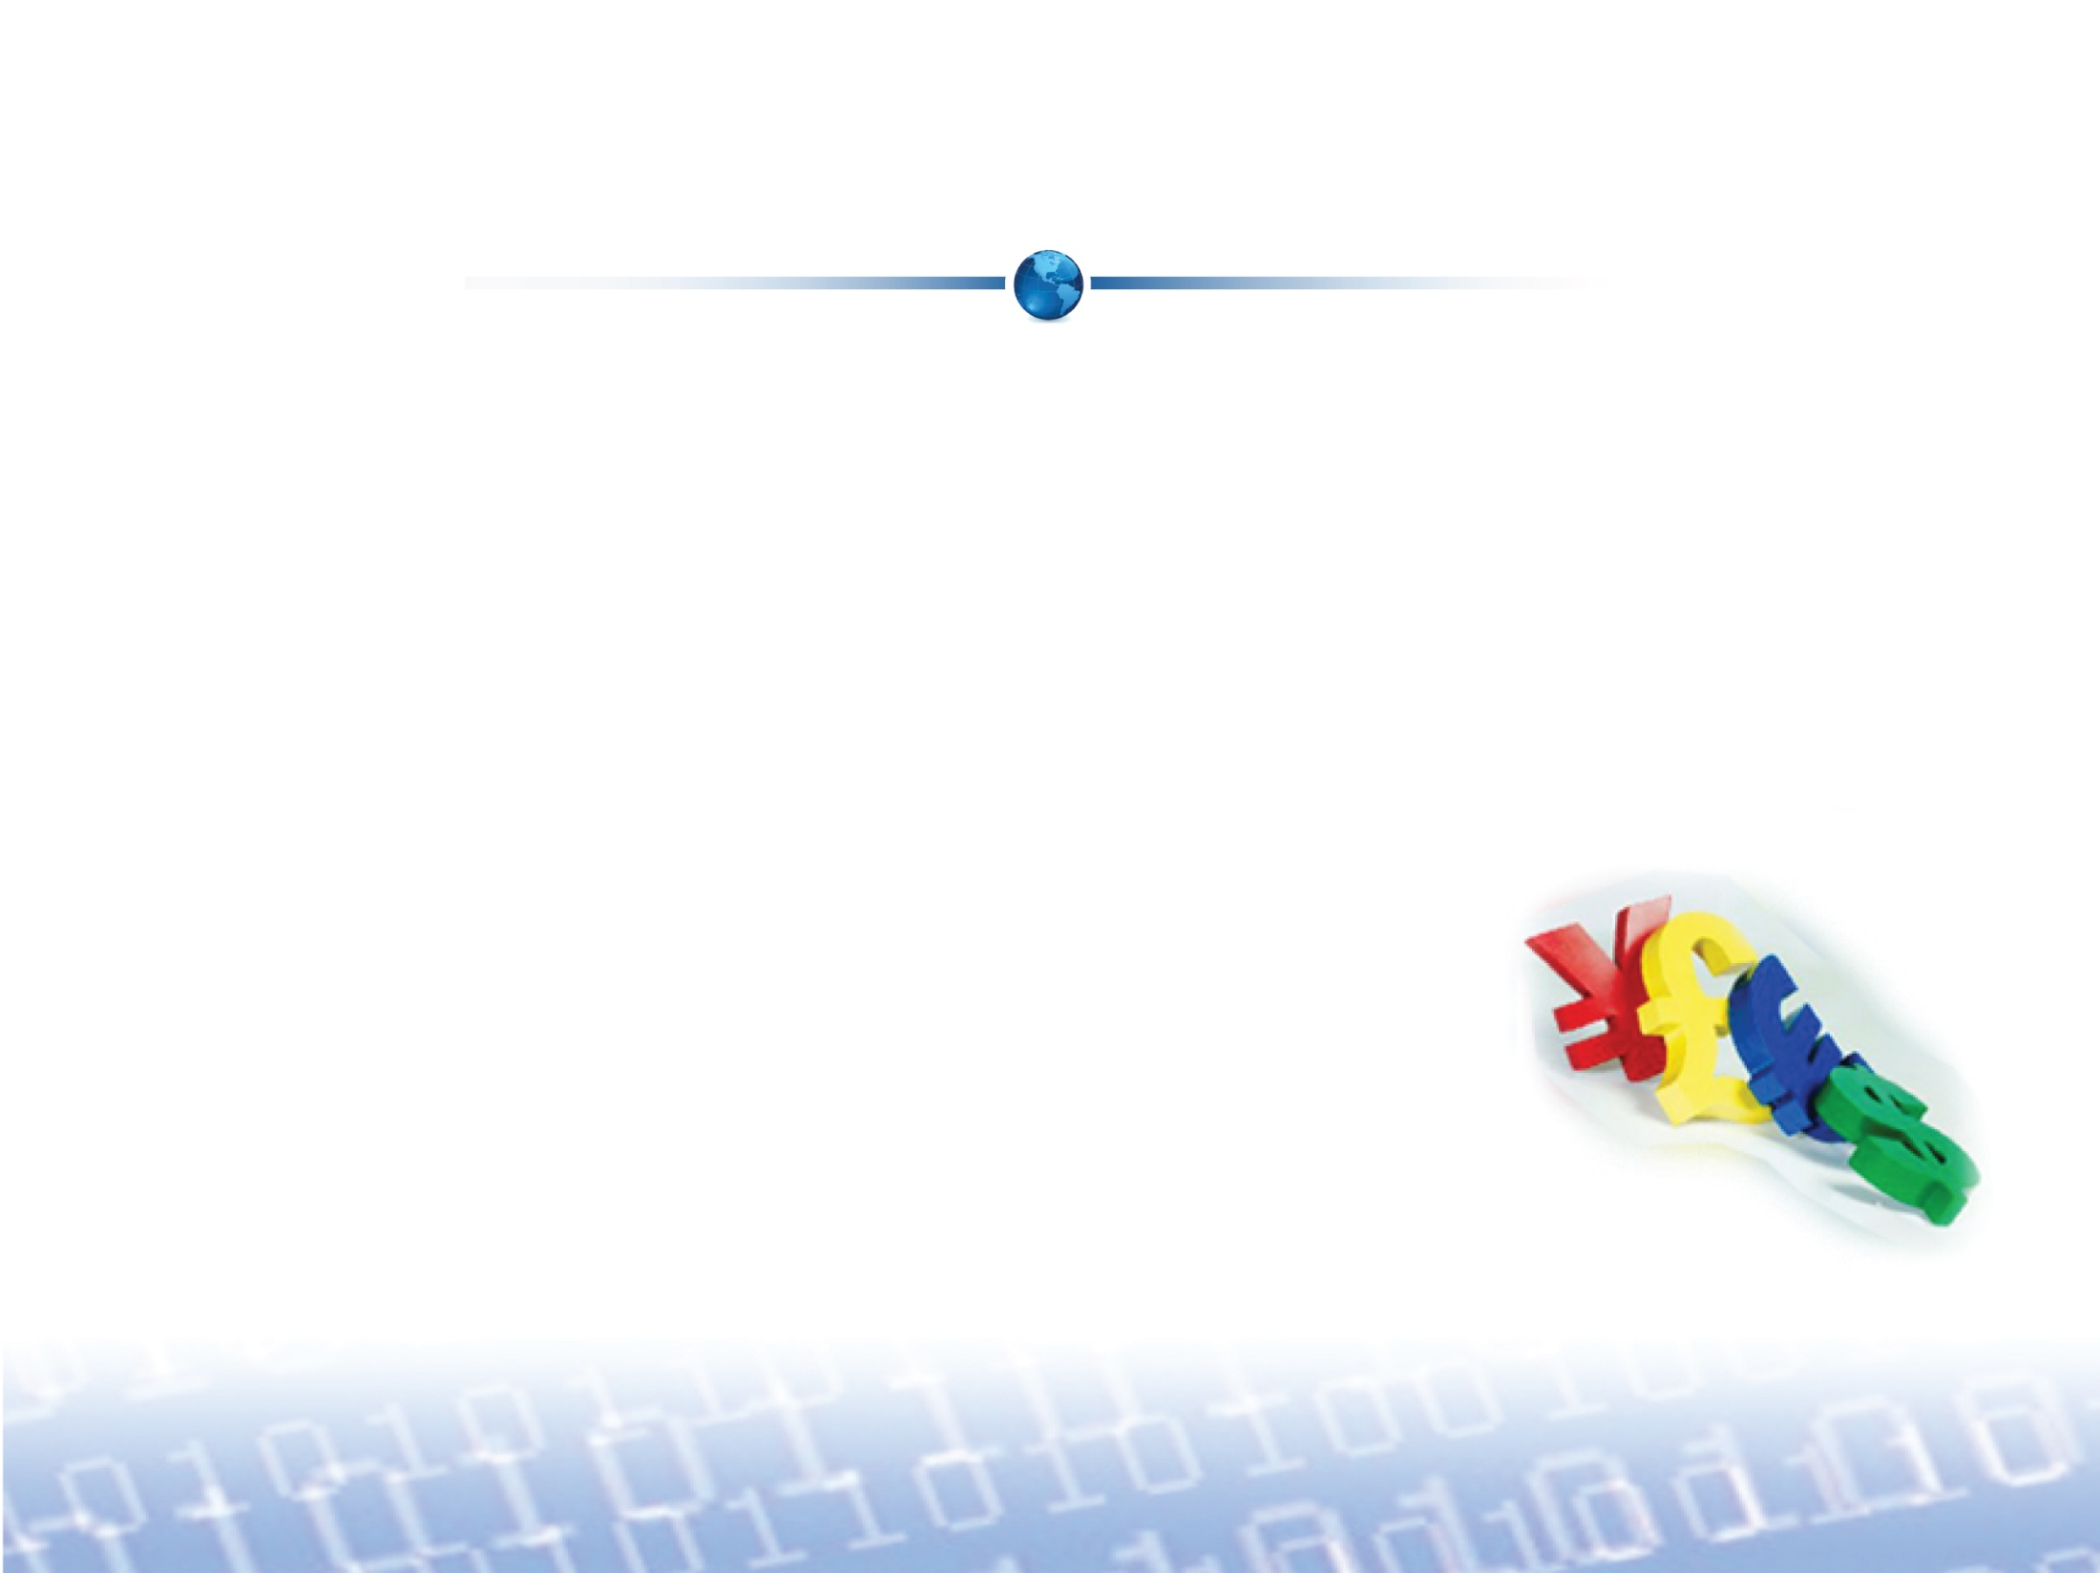
Advantages of Software Reuse
Lots of time and money go into developing an application
  This investment must be protected when platforms change
  Developers need to leverage their existing software to
  re-coup the time and money
Software reuse can be accomplished by porting
existing code to a new platform
Notes:
Many folks think that if they can re-use specs, UI, high level designs and this means software re-use. This will not give you the time and money savings. However, re-using the code will
Many folks think that software re-use means develop modular components. This only works if you do not use any third party components (OS, hardware, devices, middleware, etc.). For effective software re-use, you should also be able to swap the third party components
Concept of abstraction is hard to understand for many of the junior engineers. They are not always taught in school. Even harder to understand would be the concept of implementing abstraction that does not compromises performance
For effective software re-use, the approach had to be taken from bottom up (i.e not at the application level, but starting off at the platform components level)
It is easier to develop from what you have working rather than developing the same thing from scratch all over again
Re-use concepts is widely accepted in many industries, however when it comes to software we still are at infant stage. But things are changing.
All OS offers pretty much similar services. There is not one OS that supports all hardware or meets various certification requirements. The features offered by OS also great differ. How the application utilize the services offered by the OS greatly differ. All this things are breaking your software portability across OS. The subsequent slides mainly addresses the variations in OS platforms. Does not include the target hardware or device I/O interface differences. Please contact any of MapuSoft if you need additional information on these variations.

Slide 4
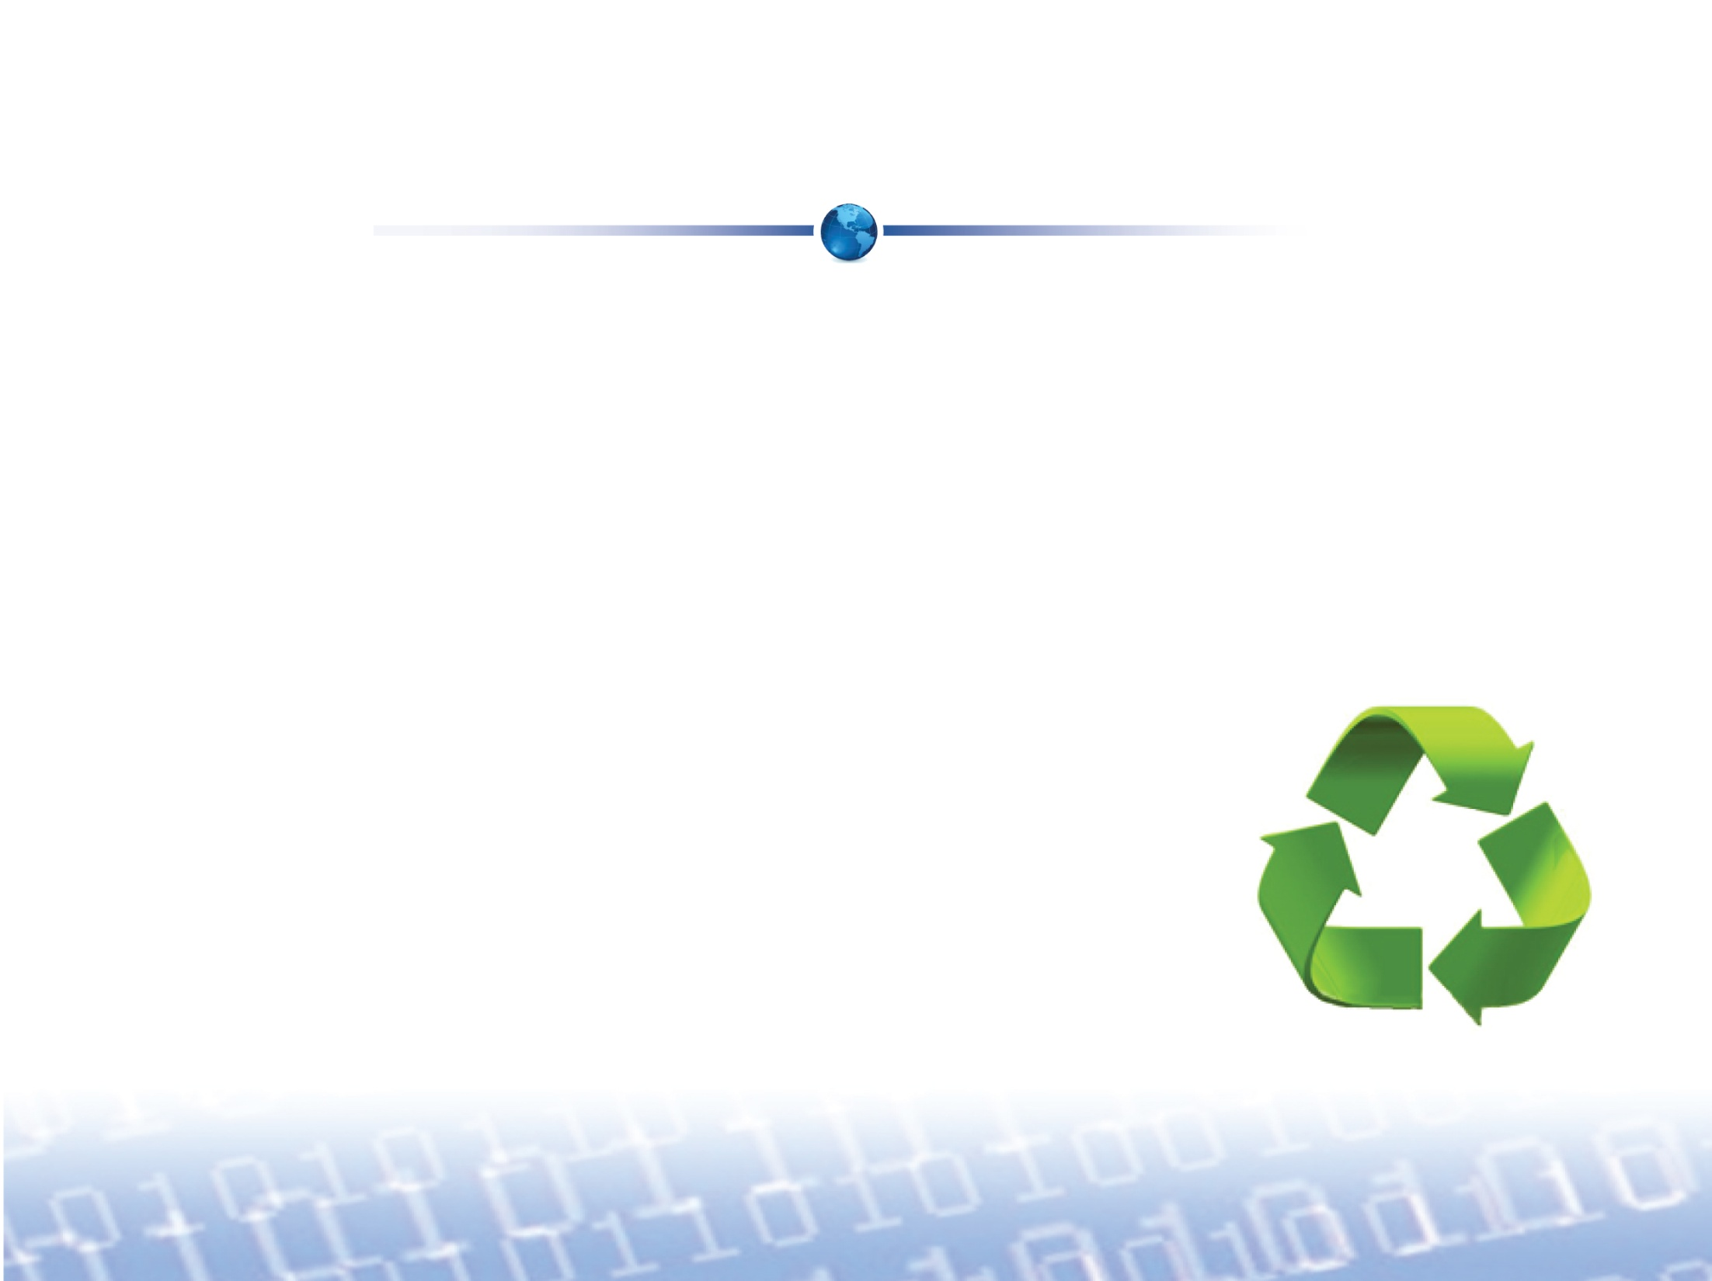
What is Porting?
Porting is the ability to reuse software from one environment to another by making minimal changes to the existing code
Porting can turn into a major code-rewrite if the underlying OS platforms are very different
  This is a tedious and error prone task
Notes:
While porting, problems seem to be coming one after another. It is also difficult to estimate how long a porting project will take and very often it is under-estimated.
Ideally, if we can totally avoid doing any porting work (it’s even more better). In this case, you may want to checkout commercial solutions like OS Changer and OS Abstractor that eliminates your porting effort
Porting = Not Fun, but it is always better & faster than a total code re-write.

Slide 5
Importance of Porting
Porting is usually quicker and cheaper than performing a full code rewrite
Existing code already works and has been perfected in the field
  Throwing it away and starting from scratch
  because of a change in environments is
  not sensible
A porting tool can greatly decrease the amount
of manual work involved
Notes:
Porting makes sense. Why re-invent the wheel?

Slide 6
Challenges in Porting
Variations in OS Platforms
Differences in OS APIs
Missing OS functionalities
Obsolete APIs
Managing multiple code bases across different
OS versions
Misleading POSIX portability
Notes:
POSIX Background: In the past, POSIX standard (1003.1) was based on UNIX. We had many UNIX OS vendors. Soon, they all started to have their own implementation and started to introduce incompatibility across the OS platforms. At that time Linux started to evolve as being the GNU standard (Did you know? The name “GNU” is a recursive acronym for “GNU's Not Unix!”;). POSIX standard is evolved a lot more now (addition of real-time & pthread extensions) and it defined under various levels of Profile (51, 52, 53 & 54). When it comes to RTOS, POSIX support is even lesser of a standard as many vendor either provide no support, little support or medium level of support. This creates POSIX code portability.
Posix and Portability
In theory, embedded applications developed using industry standard POSIX APIs are portable across multiple POSIX-based platforms if the same set of POSIX features are available across all the OS platforms. This is not always true.
In order for embedded applications to be portable, it is very important that the POSIX APIs also behave the same across all OS platforms. One example of differing behavior is the inconsistency on which a POSIX function call will suspend a calling thread when a higher priority thread is in the ready state. Embedded applications may require a calling thread to suspend when it sends a message or an event while a higher priority thread is waiting to receive the message. Conversely, an embedded application may not want the calling thread to suspend until its scheduling time slice is over. Another example is how different OS schedulers behave when load balancing threads across applications.
Using a mutex is a simple means to lock out a scheduler, prevent thread suspension, and cater to other application needs. However, a mutex decreases performance and also introduces potential deadlock situations. Ideally, embedded applications need to know which APIs will suspend the calling thread and how to avoid undesired suspensions.
Because POSIX API behavior differs across OS platforms, it is difficult to consistently meet the multitude of application requirements. To maintain code portability, developers need a POSIX solution that strictly adheres to standards, meets embedded application needs in a non-intrusive manner (i.e. without breaking POSIX compliancy), and provides consistency in API behavior. For example, a solution suitable for telecom type applications might have a configuration option that allow all the POSIX threads to always run-to-completion before giving up control to the scheduler. A controller type application may require that a higher priority thread take control and run immediately when the suspension is lifted as opposed to allowing the current thread to finish its allotted CPU time slice. Mission critical applications may require that all the resources are statically pre-created to avoid failures during run-time (i.e. reserving memory, allocating control blocks up front, re-using threads from thread pools, etc.).
It takes more than just mimicking POSIX APIs to make embedded applications portable across OS platforms. The consistency of API behavior must also be considered. MapuSoft’s POSIX OS Abstractor is designed to meet the needs of various embedded applications with performance and full code portability in mind while allowing developers to add features without breaking POSIX compliancy.

Slide 7
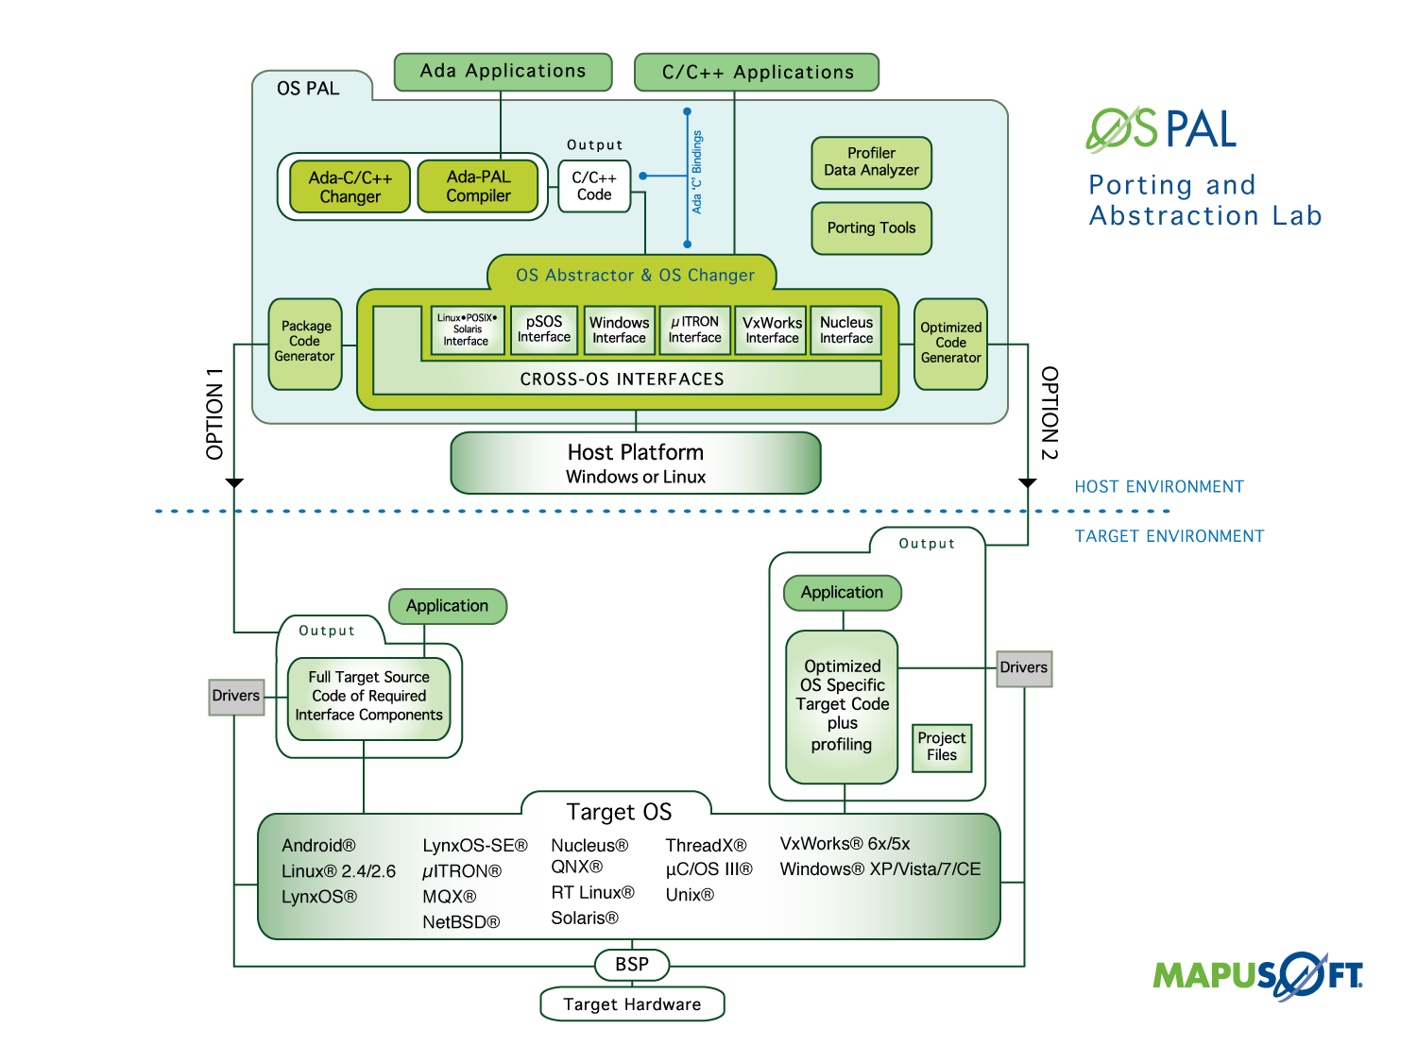

Slide 8
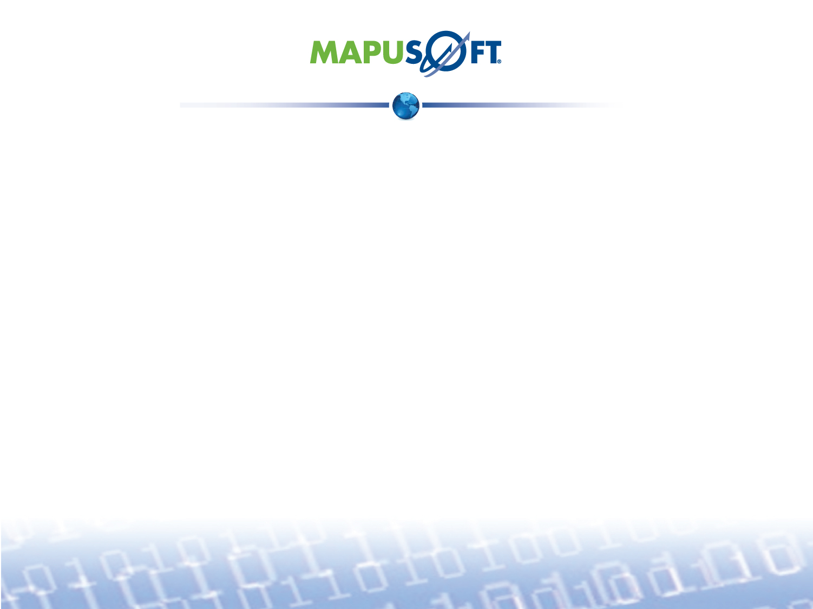
For More Information
To download MapuSoft’s free software evaluation visit: http://mapusoft.com/downloads/
For any additional information please contact MapuSoft at: http://mapusoft.com/contact/
Toll Free: 1-877-MAPUSOFT
OS Changer, OS Abstractor, Cross-OS, OS Simulator, OS PAL, Ada-C/C++ Changer and Mapusoft are trademarks of Mapusoft Technologies, Inc. All other brands or product names are the property of their respective holders. This content is copyrighted by MapuSoft. Content is subject to change without notice.

