Slide 1
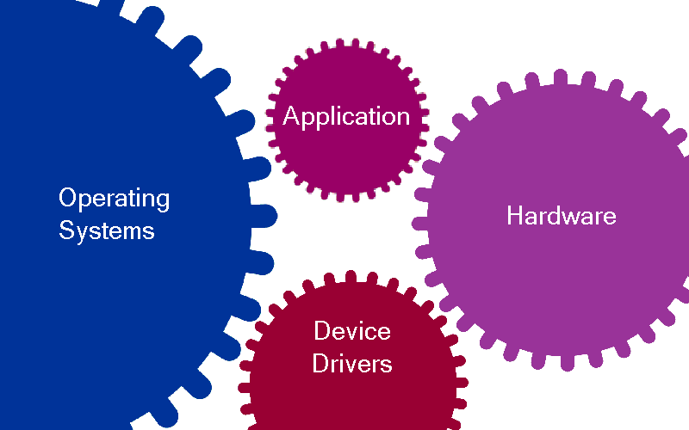
Developing OS Agnostic Embedded Applications
Presenter: Raj Johnson
Notes:
Application runs on a platform comprises of target OS, hardware & devices (as shown above)
Traditionally, development team puts in a lot of effort (time & money) into completely re-architecting the Application and platform components for next generation
The recent economic downturn, constantly changing platform environment and pressure to protect software investment challenges the engineers to seek alternatives to traditional development and take a serious look at porting and abstraction solution.
Engineers are now challenged to build components that are modular and abstracted from each other with an emphasis on leveraging on existing software
There is a strong push to develop cheaper products (reduced bill-of-material cost) with lower development cost. In order to accomplish this, engineers need to ensure that their software is not tied to a specific OS, hardware & devices

Slide 2


Getting Locked-In
Applications are developed with a particular platform in mind
  The software is locked to the current platform
  If a component of that platform changes, the application will no longer run without costly changes to the code due to variances in platforms
Reasons platforms change
  Changes in technical requirements
  Switching to more economical platforms
  Platform becomes obsolete
  Market & industry demands
Notes:
You are the full owner of your software. Unfortunately if your software can only work on a specific OS vendor’s platform, the vendor almost have a lien on your software. You are betting on your vendor to be around for the life of your product. You are also betting that the vendor will offer you good products and services at a reasonable cost. Why put all your eggs in one basket? What happens to your software when the platform goes obsolete? (answer: your software goes obsolete as well)
In the past, the platform components was not changing so much. Your customer didn’t even care what OS, hardware, etc. as long as your product works and priced right
Now a days, platform component change rapidly. Platform vendors are spending considerable marketing dollars to promote specific platforms and creating new markets where you may see your customers directly asking you to support a specific platform (e.g Linux, Android market)
Changes in technical requirements: better performance, use a safety standards based OS, or use a OS that has wide driver/middleware support, etc
Why not give freedom to your software? Why not give your software a longer life?

Slide 3
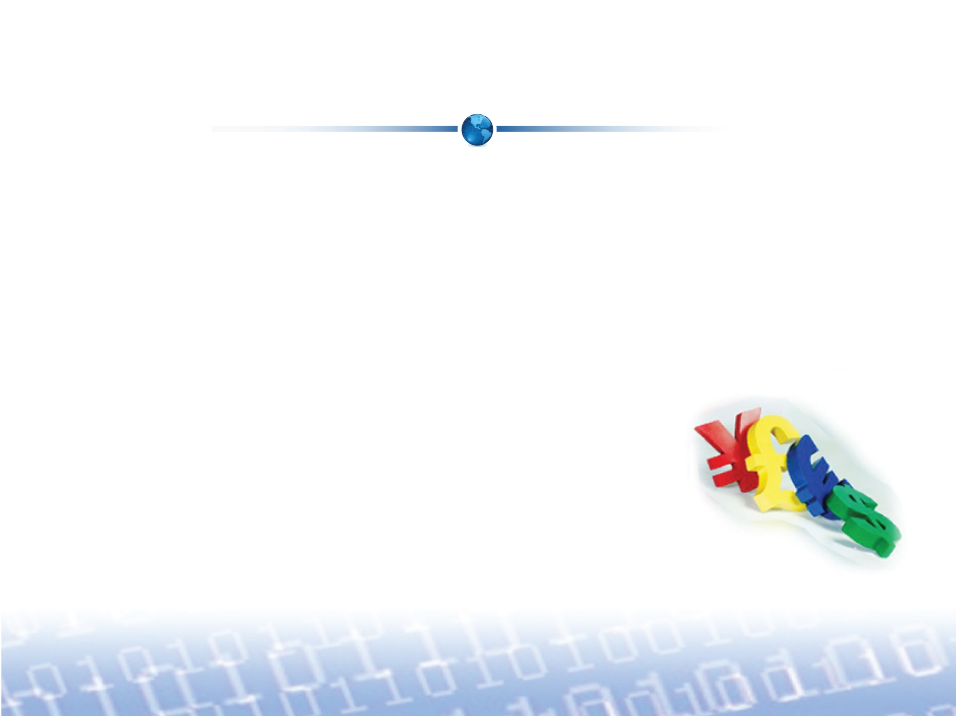
Advantages of Software Reuse
Lots of time and money go into developing an application
  This investment must be protected when platforms change
  Developers need to leverage their existing software to
  re-coup the time and money
Software reuse can be accomplished by using an abstraction platform for new code development
Notes:
Many folks think that if they can re-use specs, UI, high level designs and this means software re-use. This will not give you the time and money savings. However, re-using the code will
Many folks think that software re-use means develop modular components. This only works if you do not use any third party components (OS, hardware, devices, middleware, etc.). For effective software re-use, you should also be able to swap the third party components
Concept of abstraction is hard to understand for many of the junior engineers. They are not always taught in school. Even harder to understand would be the concept of implementing abstraction that does not compromises performance
For effective software re-use, the approach had to be taken from bottom up (i.e not at the application level, but starting off at the platform components level)
It is easier to develop from what you have working rather than developing the same thing from scratch all over again
Re-use concepts is widely accepted in many industries, however when it comes to software we still are at infant stage. But things are changing.
All OS offers pretty much similar services. There is not one OS that supports all hardware or meets various certification requirements. The features offered by OS also great differ. How the application utilize the services offered by the OS greatly differ. All this things are breaking your software portability across OS. The subsequent slides mainly addresses the variations in OS platforms. Does not include the target hardware or device I/O interface differences. Please contact any of MapuSoft if you need additional information on these variations.

Slide 4
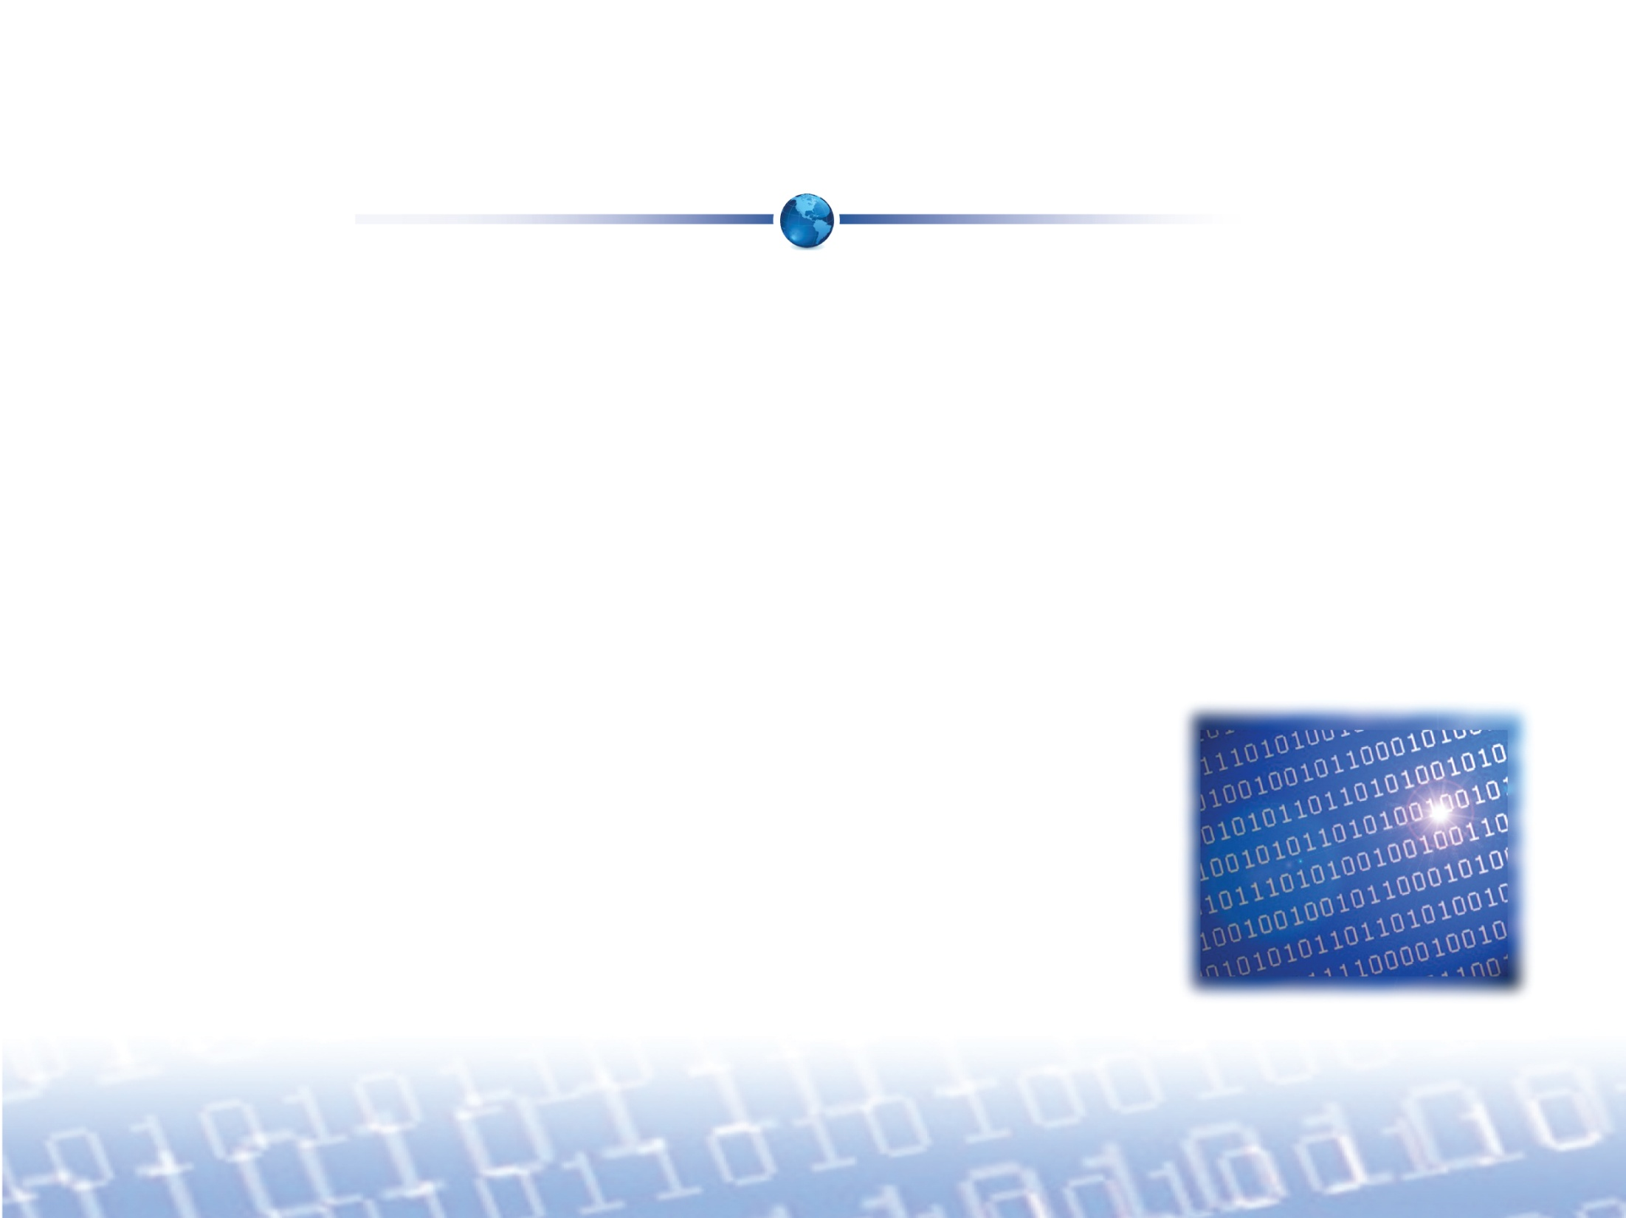
What is Abstraction?
Abstraction provides the ability to develop software that can be re-used across multiple environments without changing the code
A good abstraction protects software investment
  Keeps it from being locked-to a particular platform
  from day one
Notes:
Good abstraction should eliminate your application porting effort
Gives you a better negotiating power when purchasing platform components (as your software is not locked-in)

Slide 5
Importance of Abstraction
Negates future porting issues and protects the code
  Avoids shifting the focus from the organization’s core competencies
Ensures that the fundamental OS resources behave the same across all platforms
Reduces potential learning curve and makes
the concept of code reuse easier to adopt

Slide 6
Importance of Abstraction
Allows for development of host based proof-of-concept application quickly
Product development knowledge is not locked
to a specific vendor’s tools, IDE or platform
Hardware changes won’t impact applications
  Application development team can keep
  developing without worrying about
  changes to the hardware or underlying
  platform
Notes:
Hardware changes: OS Abstractor provides a blanket of security for these situations. It allows you to continue your application development while the BSP team deals with the hardware change. It provides a layer of separation between your BSP / driver development and your application development. So when you do change hardware, you can continue with your application development safely and on schedule.

Slide 7
Challenges in Abstraction
Has to support a variety of operating systems and account for new versions in the future
Should not impact the application’s performance
Should not fully rely on the underlying OS
Notes:
A wrapper functions just maps an abstraction API to the underlying equivalent OS API. Abstraction API implementation needs to be “wrapper-less” as much as possible. Also should take advantage of compile-time translations to minimize run-time impact
Abstraction design should include performance improvements and application specific platform optimizations as key goals
Abstraction design should have mechanism to collect performance data so that when platform component changes you can always compare the performance on the new with the previous platform
Abstraction should be designed in such a way that they can actually run on a variety of OS types that was discussed in the previous slides
If an OS miss a specific feature, the Abstraction should provide that feature to provide portability to your application
Abstraction implementation should always utilize lower-level OS API features for better performance

Slide 8
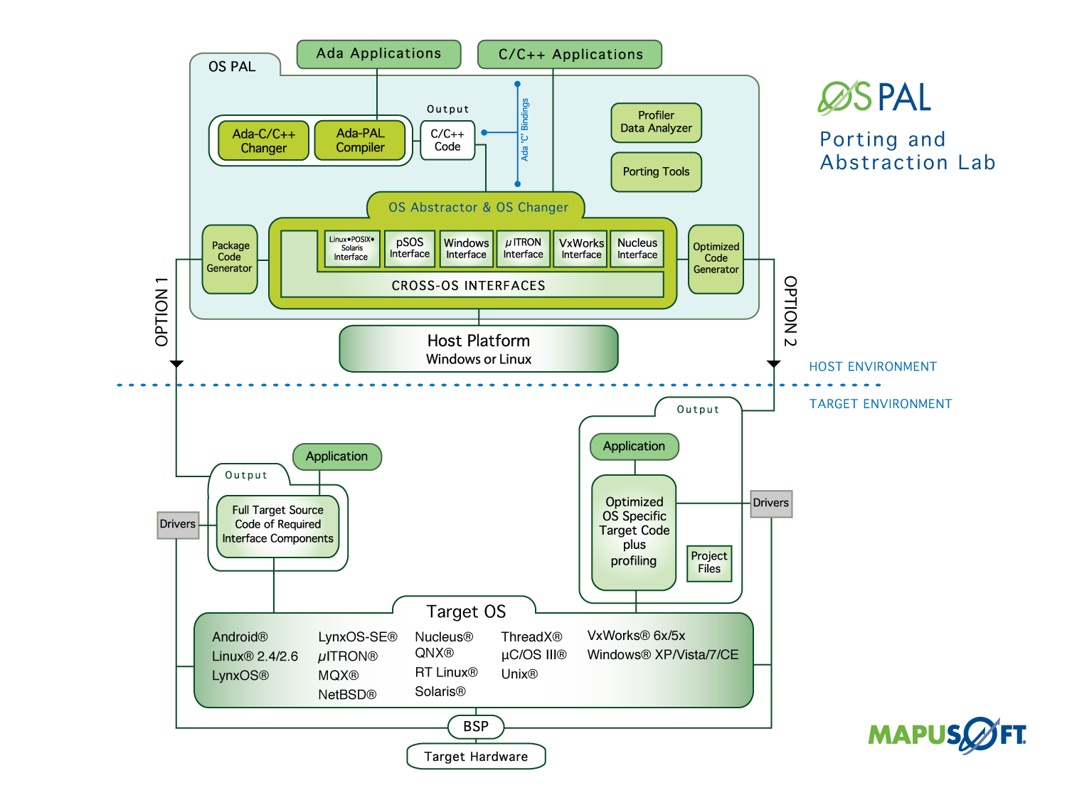

Slide 9

For More Information
To download MapuSoft’s free software evaluation visit: http://mapusoft.com/downloads/
For any additional information please contact MapuSoft at: http://mapusoft.com/contact/
Toll Free: 1-877-MAPUSOFT
OS Changer, OS Abstractor, Cross-OS, OS Simulator, OS PAL, Ada-C/C++ Changer and Mapusoft are trademarks of Mapusoft Technologies, Inc. All other brands or product names are the property of their respective holders. This content is copyrighted by MapuSoft. Content is subject to change without notice.

