Slide 1
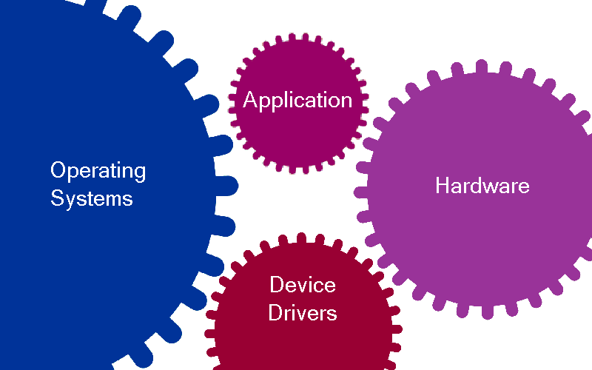
Testing Embedded Applications Using OS Virtualization
Presenter: Raj Johnson

Slide 2


OS Virtualization-based Test Platforms
Test your entire system of applications on a single host utilizing an OS simulator
Test only a module, while loosely integrating with the rest of the system on a host

Slide 3
Return on Investment
Reduce testing effort by using a host rather than the restricted target platform
Reduce testing cost by using host rather than the expensive target platform
Simulate a complex system on one host machine and reduce the hardware cost
Make sure you are not getting locked in to a specific OS vendor’s simulator

Slide 4
Establish Testing Goals
What percentage of code is tested on simulator versus real hardware
Determine which timing characteristics are not covered by the simulator and should be tested on real hardware
Test multiple targets on a single host to save platform hardware cost
Take full advantage of the host platform’s middleware, stack, tools & drivers

Slide 5
Features to Look For
Single tool supporting multiple OS simulation allows for testing variety of applications
Generation of optimized OS Simulator source code to allow applications to utilize native host tools for testing
Generate application performance metrics and analyze data in graphical viewer to look for bottlenecks

Slide 6
Features to Look For
Support Module Based Testing
  Load/unload individual module (application) as separate processes so that module under test will not stop the rest of the modules from functioning
  Define and guarantee resource requirements (memory, kernel objects) upfront for each module
  Easily setup communication between modules either based on shared memory or netstack
  Easily simulate devices and data flow across modules on host

Slide 7
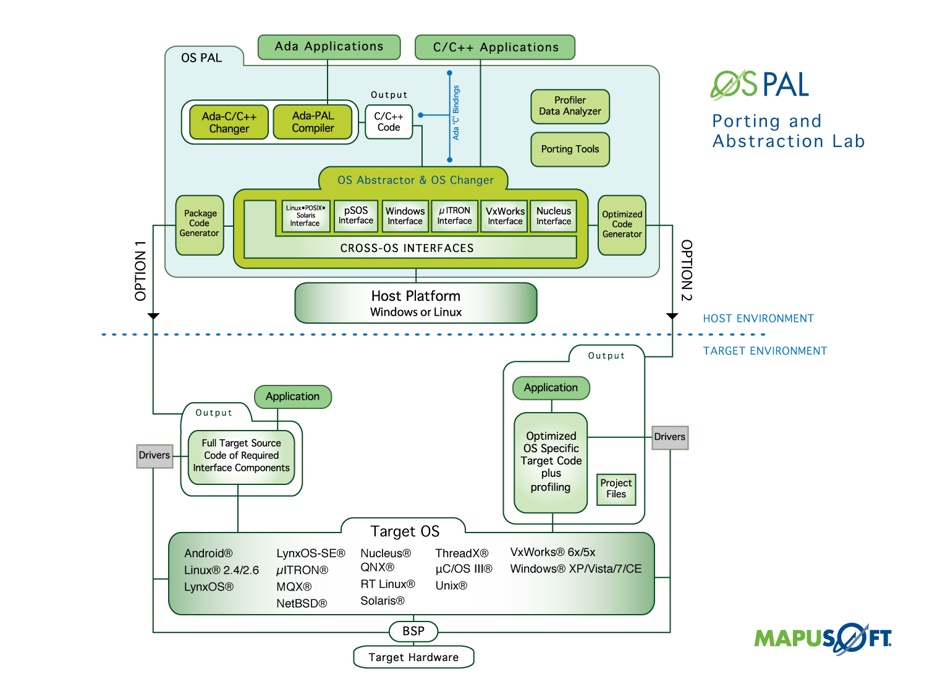

Slide 8

For More Information
To download MapuSoft’s free software evaluation visit: http://mapusoft.com/downloads/
For any additional information please contact MapuSoft at: http://mapusoft.com/contact/
Toll Free: 1-877-MAPUSOFT
OS Changer, OS Abstractor, Cross-OS, OS Simulator, OS PAL, Ada-C/C++ Changer and Mapusoft are trademarks of Mapusoft Technologies, Inc. All other brands or product names are the property of their respective holders. This content is copyrighted by MapuSoft. Content is subject to change without notice.

