Slide 1
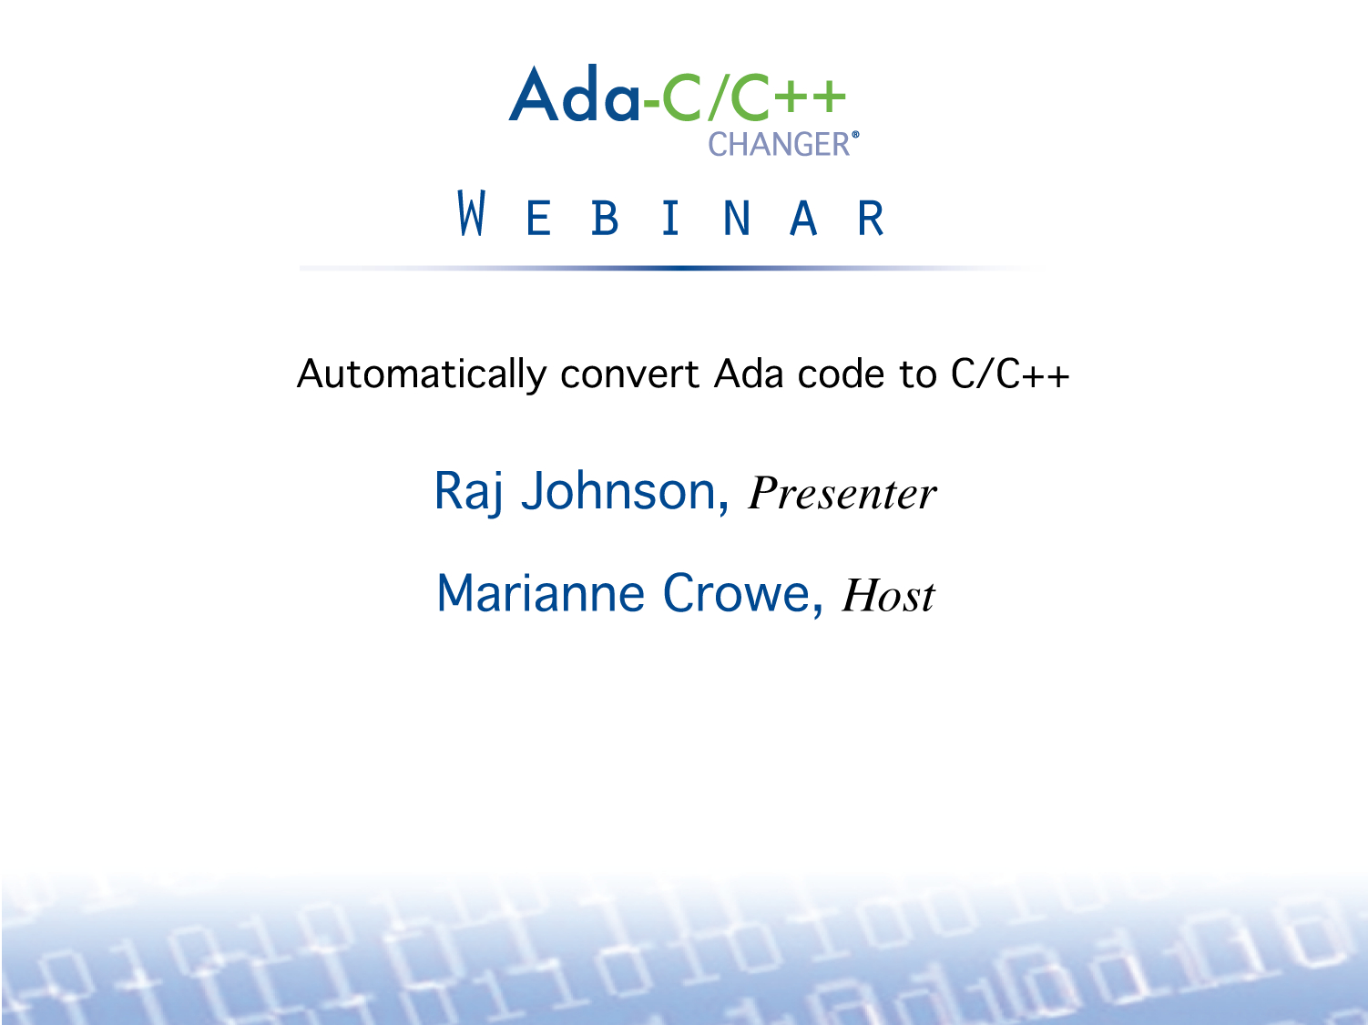

Slide 2
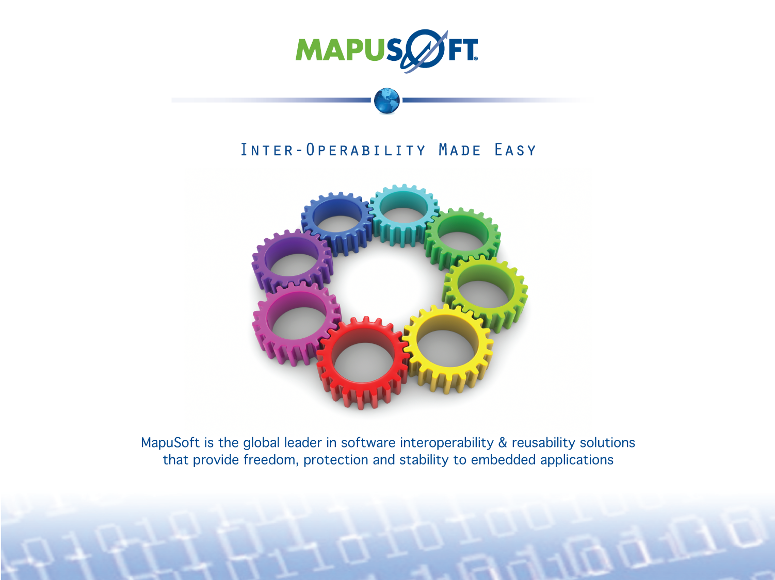

Slide 3

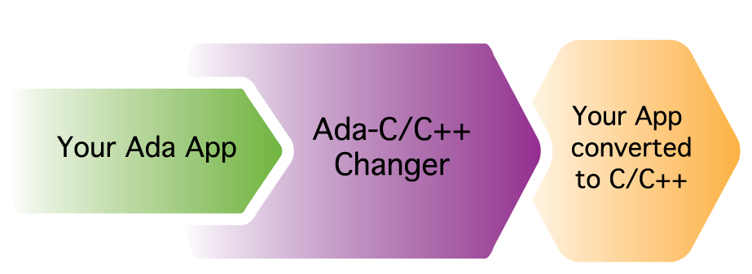

Slide 4
Ada-C/C++ Changer
Automatically convert Ada code to C/C++
Eliminate the need for a costly and tedious code re-write for extensive cost and time savings
Error free tool that prevents mistakes made in the error prone task of a manual rewrite
Resultant C/C++ code can be integrated with OS Abstractor for real-time performance, portability and stability

Slide 5
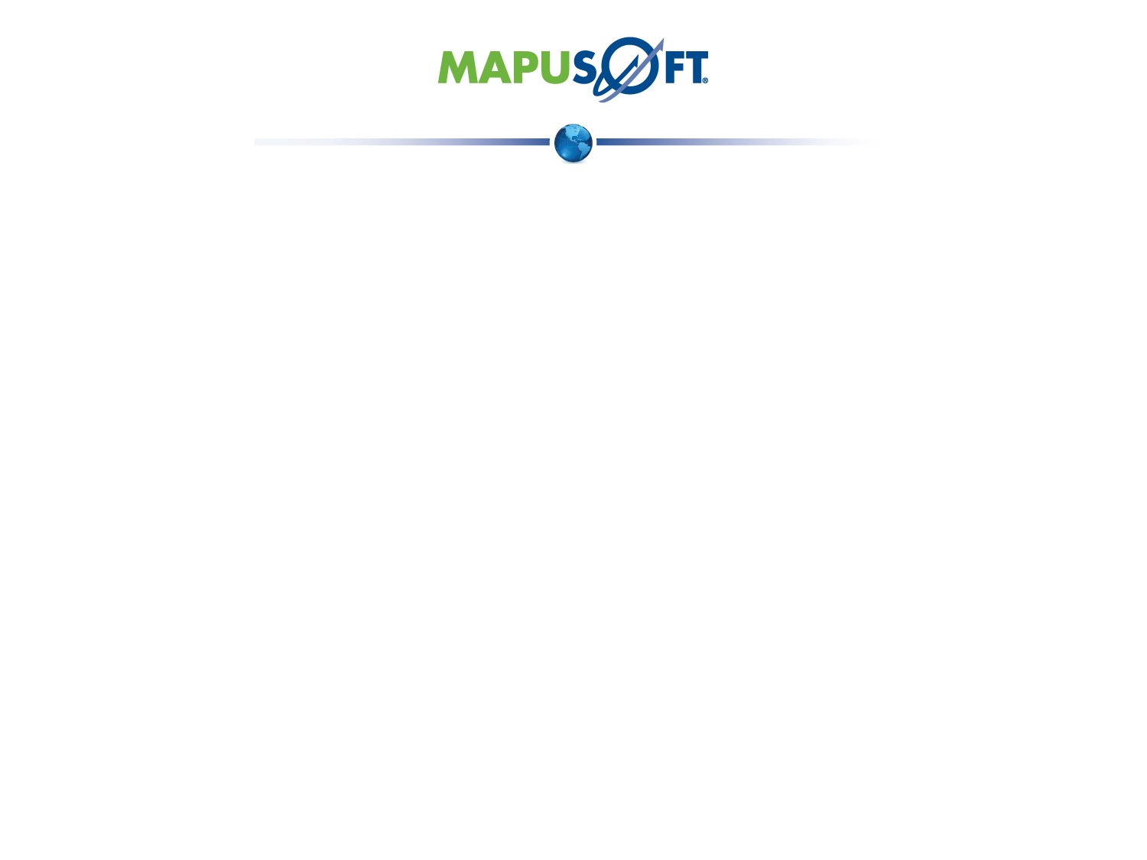
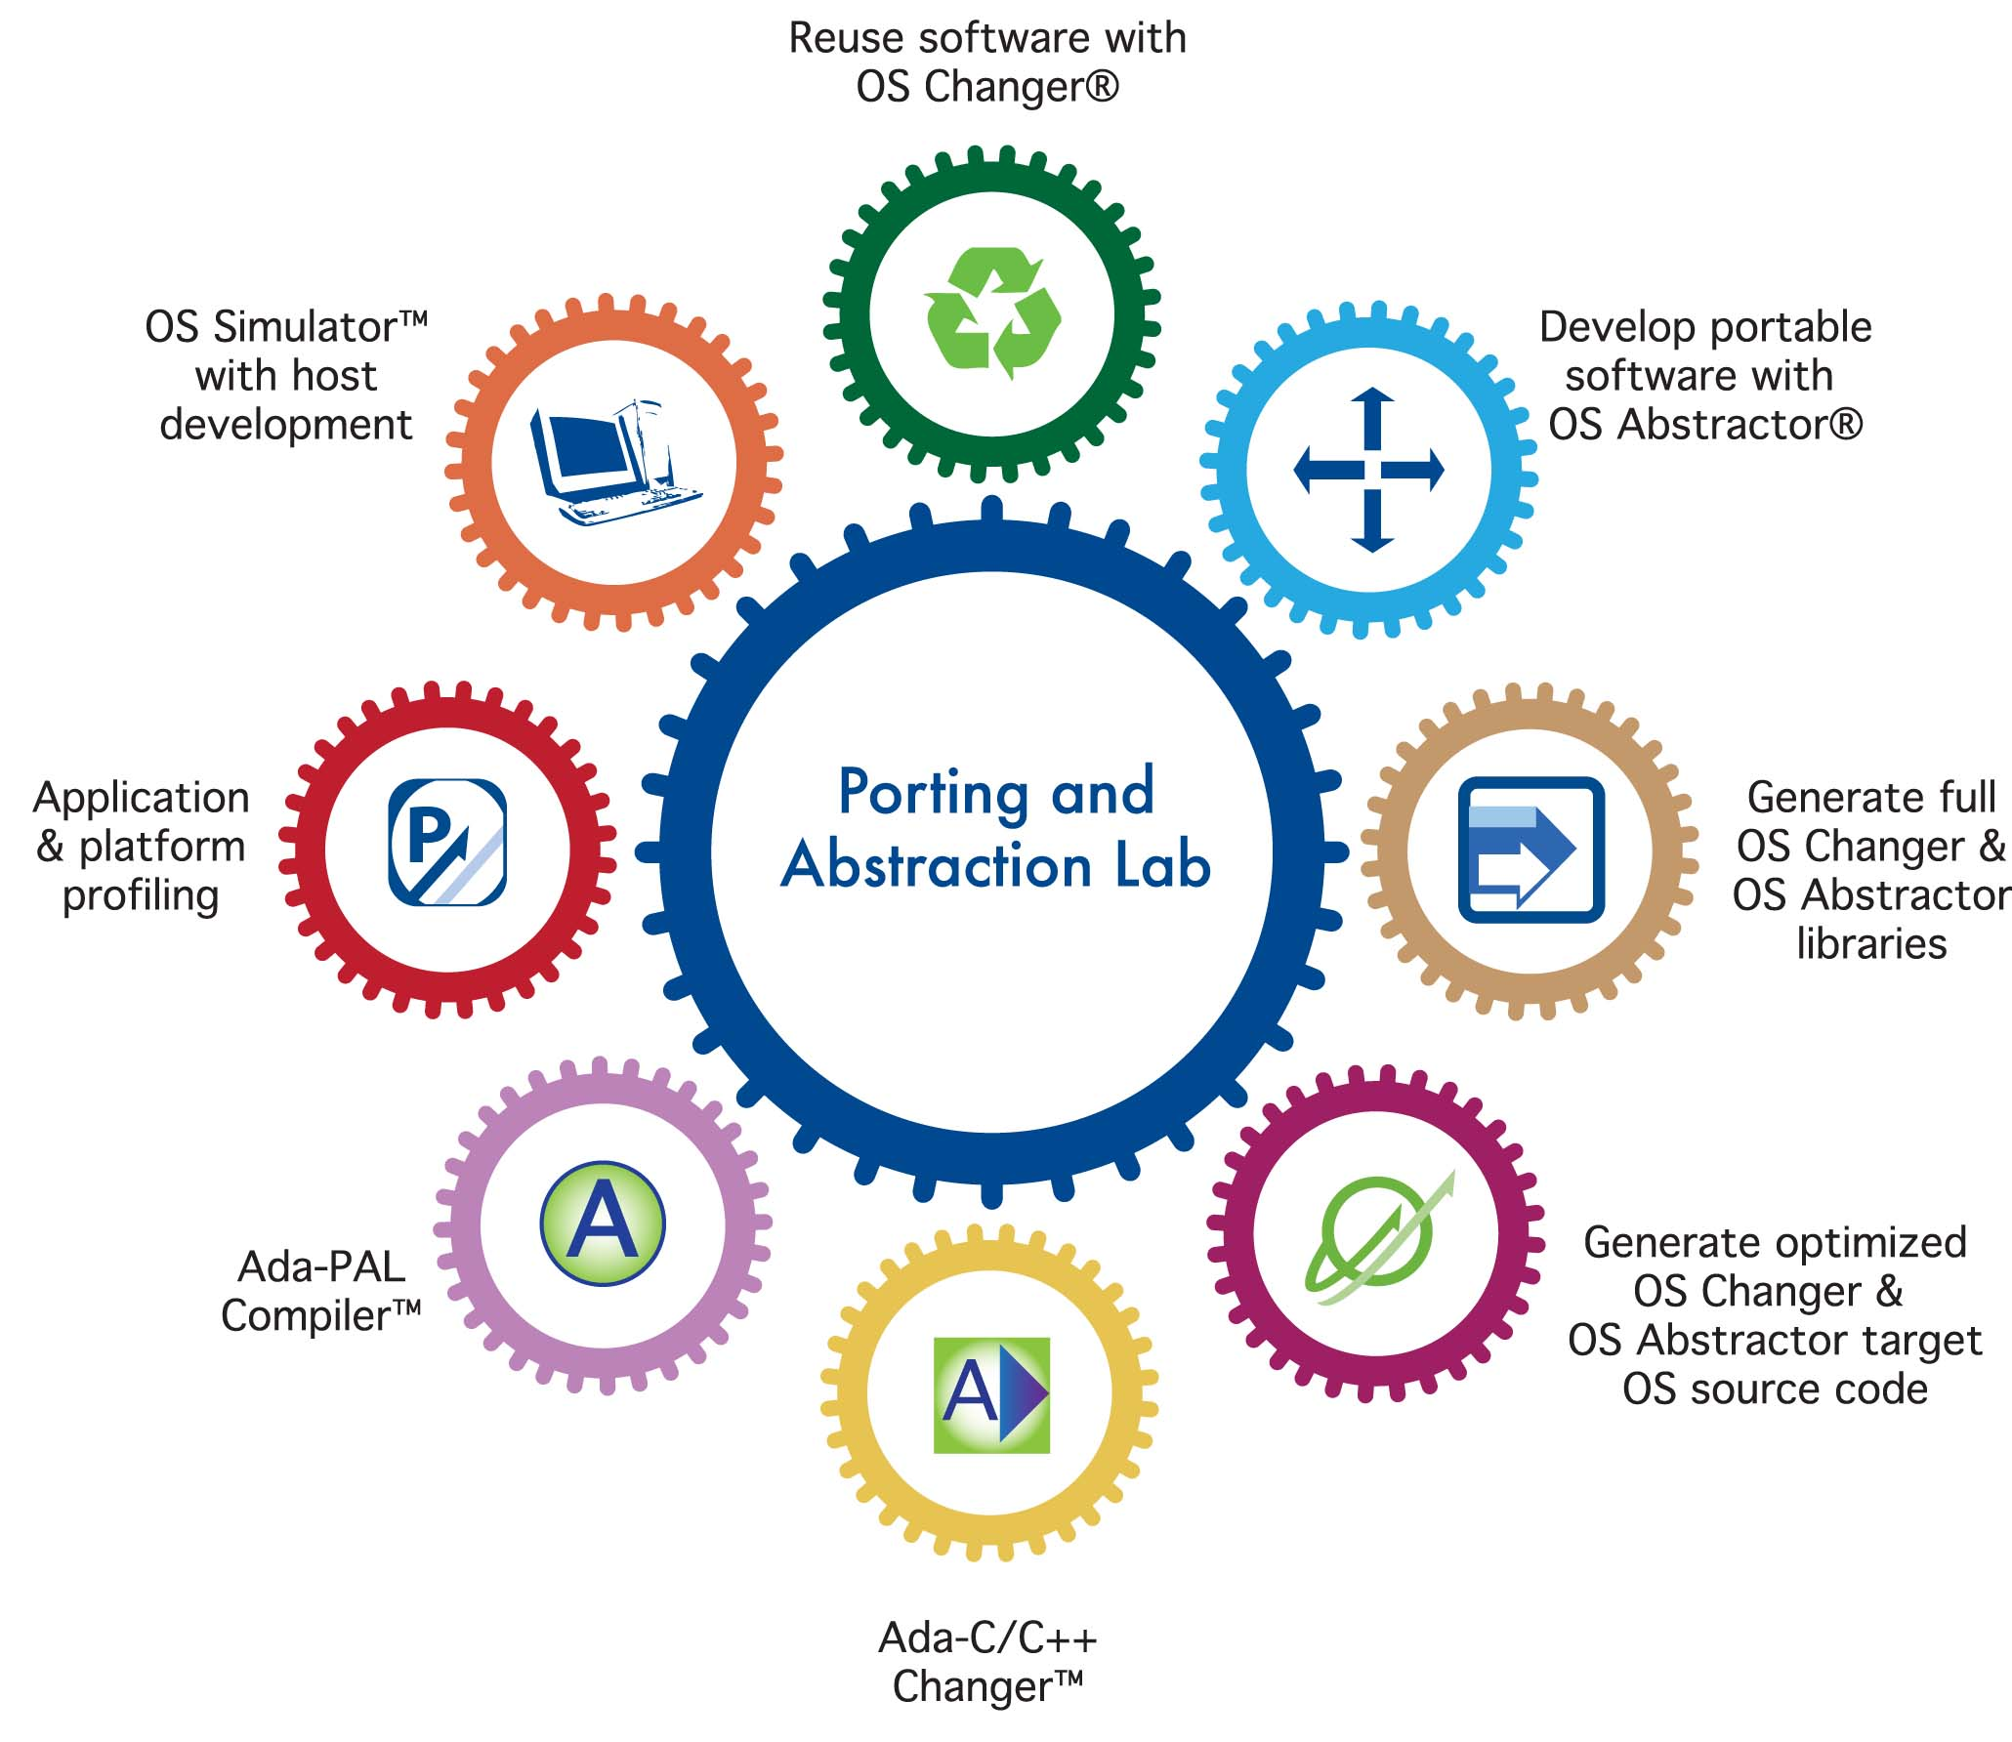

Slide 6
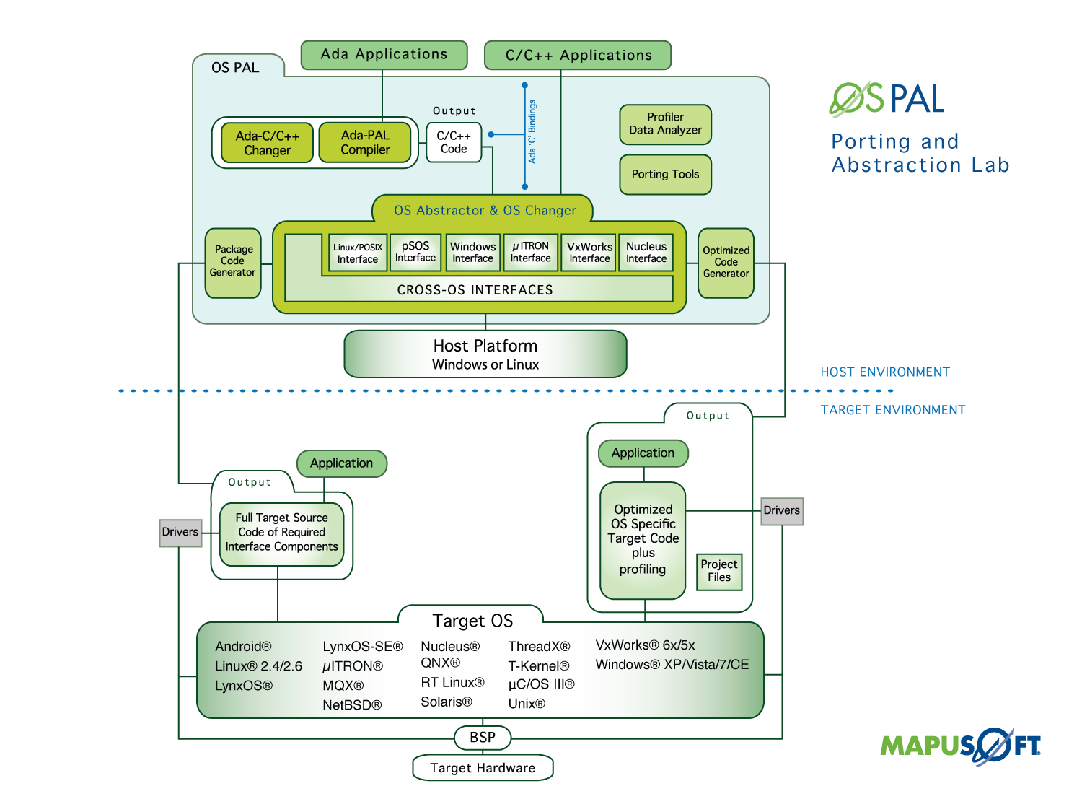

Slide 7
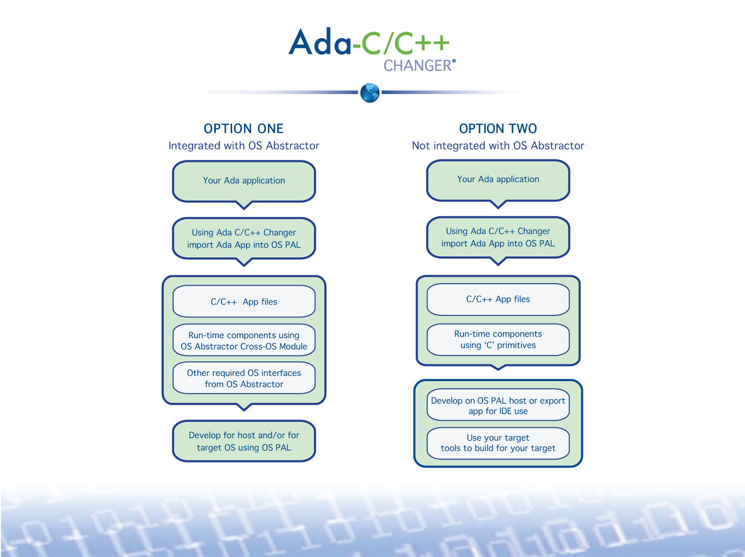

Slide 8
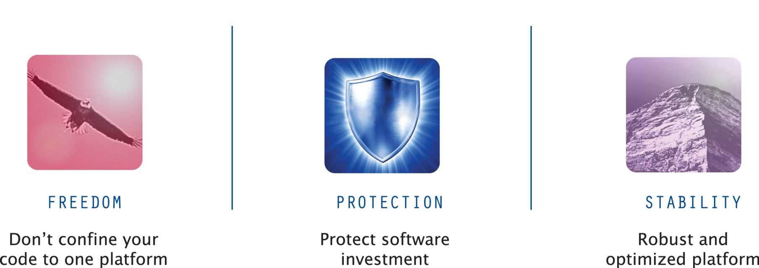

Slide 9
For More Information
To download MapuSoft’s free software evaluation visit:
http://mapusoft.com/downloads/
For any additional information please contact MapuSoft at
http://mapusoft.com/contact/
Toll Free: 1-877-MAPUSOFT
OS Changer, OS Abstractor, Cross-OS, OS Simulator, OS PAL, Ada-C/C++ Changer and Mapusoft are trademarks of Mapusoft Technologies, Inc. All other brands or product names are the property of their respective holders. This content is copyrighted by MapuSoft. Content is subject to change without notice.

