Slide 1
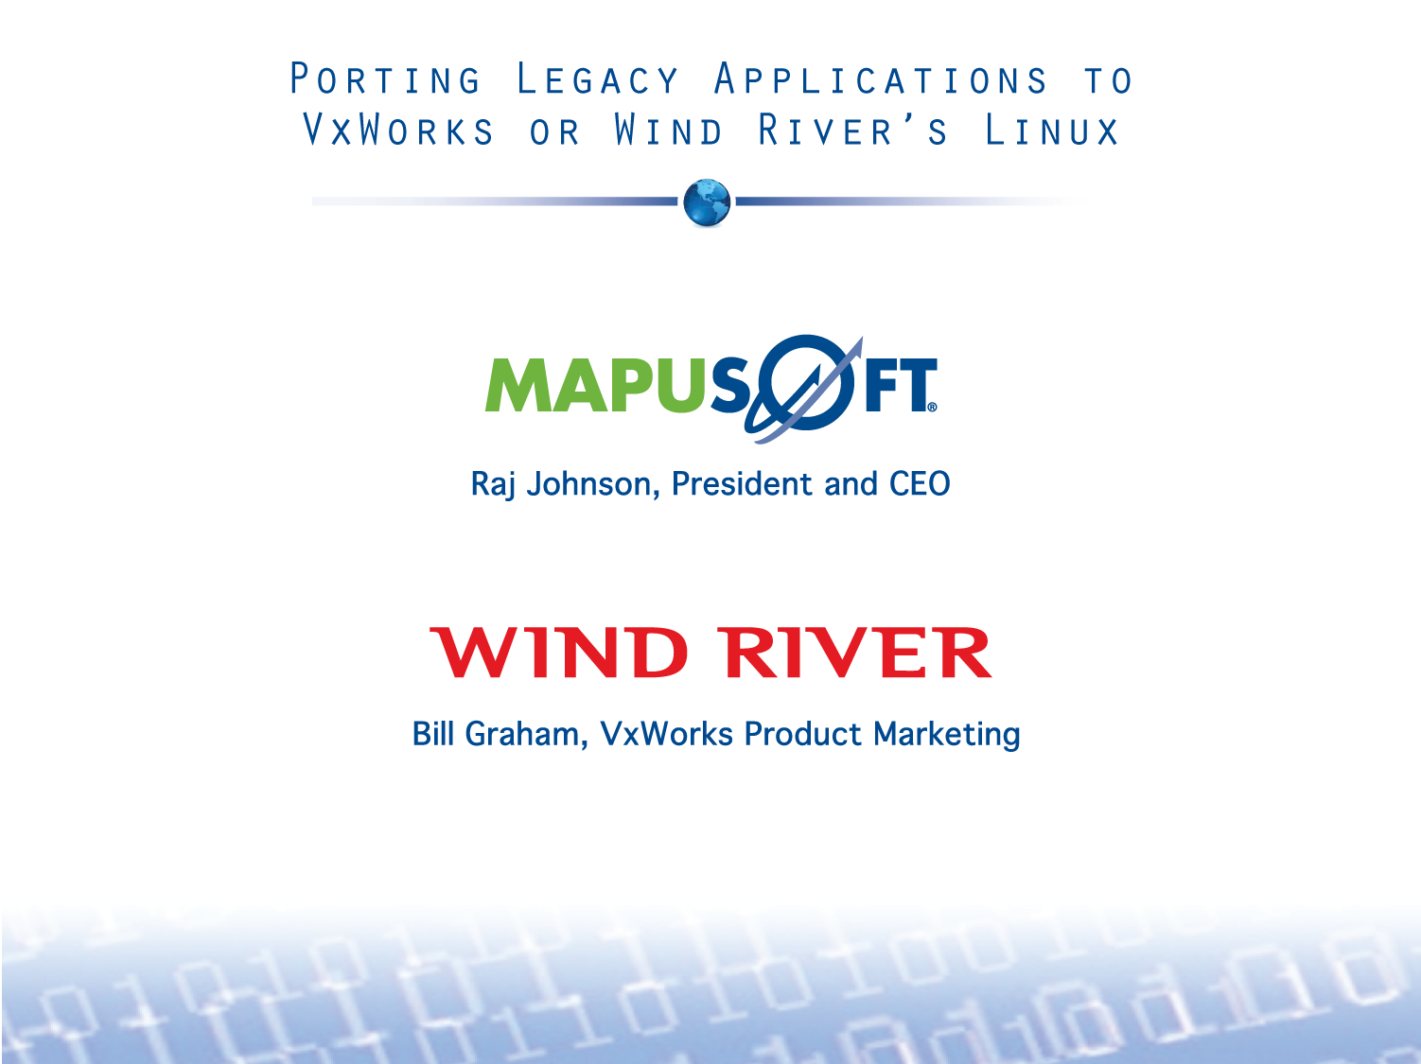

Slide 2
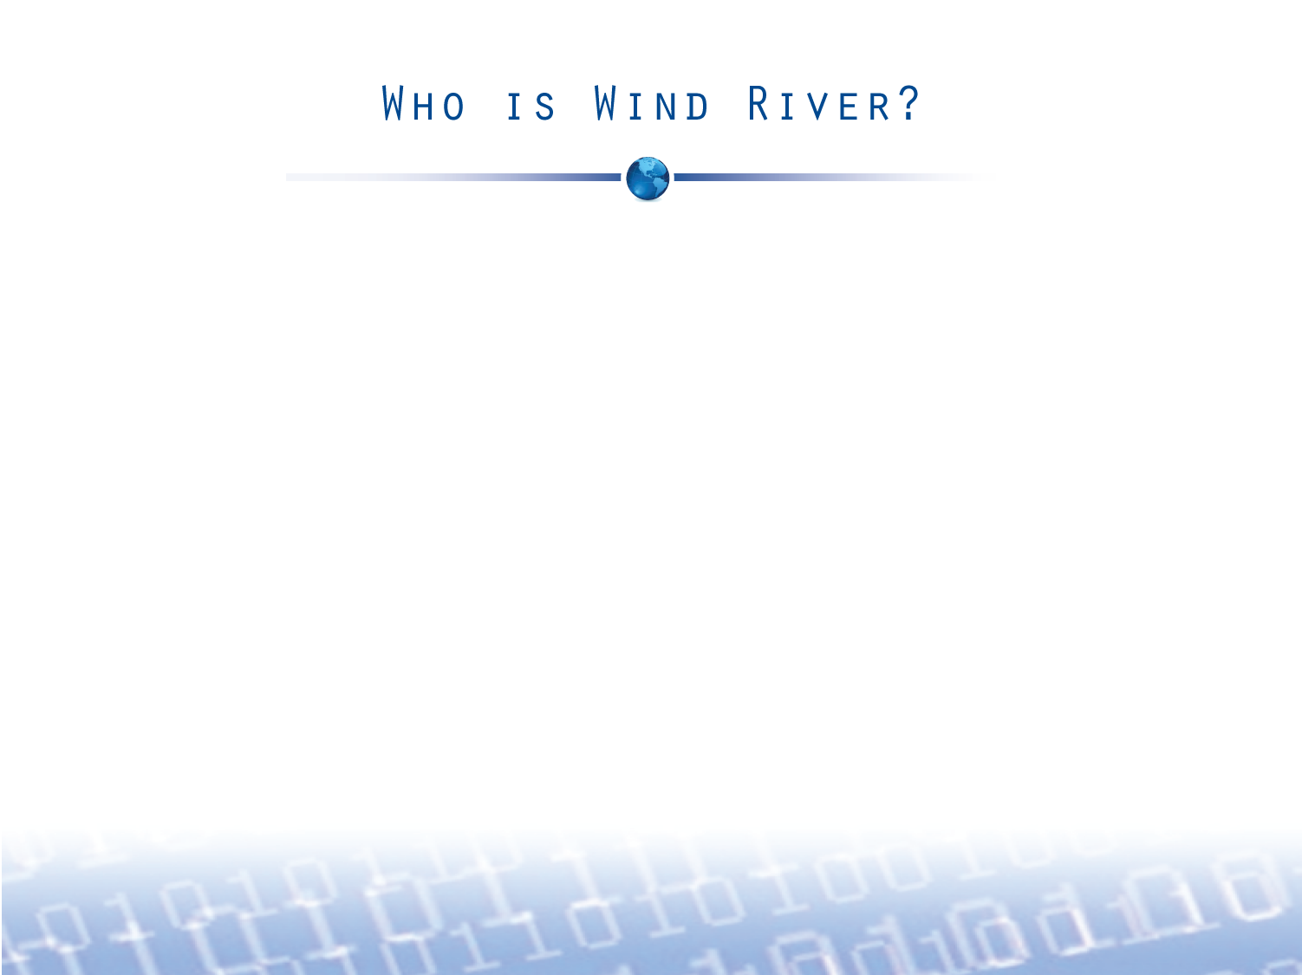

$360M in revenue (FY’09)
9% increase
year-over-year
Leading RTOS
VxWorks
Leading Embedded Linux
Wind River Linux
Innovation Leader:
Multicore
Multi-OS
Safety, Security
$169M
in cash, cash equivalents and investments
(FY’09)
250+
Hardware and Software Partners
200+
Worldwide Service, Support and Training Personnel
42,000+ developers
500+ million deployed devices
Notes:
2
2
What is it that truly makes Wind River unique, and uniquely successful? First of all, we’re a leader. We’re not just a technology leader and technology innovator, but we’re a market share leader in device software optimization. Depending on which industry analyst is your favorite, we have anywhere from 35 to 45 percent of the commercial market. That’s true whether you’re looking at a particular industry or across proprietary real-time or commercial Linux—virtually any way you look at it, we are the market share leader.
[BUILD]
Second, we are big and we are stable. Our customers are multi-billion dollar companies. If you look at our revenue in the last fiscal year, we were just under the $360 million mark. More importantly, that is a nearly
10% increase year-over-year—despite the dire economic climate around us. No other company in our space can boast that. Not one company.
[BUILD]
Also, because our business is heavily subscription-oriented, you should also take the $132 million in deferred revenue into account. And now operating as an Intel subsidiary, the world’s largest silicon maker, our ability to execute and deliver is even greater, which we’ll cover in a few minutes.
[BUILD]
We don’t just create revenue and drive growth at the top line, we do it in a very profitable way—putting money to the bottom line. And we will continue to take a lot of that profit and put it back into our business. Last year we spent over $84 million on R&D. That is more investment in our own technology than any company in our space makes in revenue.
[BUILD]
So we spend more to build products than what other companies make, and that’s very important because you know when you go with Wind River, you’re going with a leader. We have close to $170 million in cash, cash equivalents and investments, and as a subsidiary, we will continue to look at M&A activity to grow Intel’s software business, not just in organic terms, but also via more acquisitions.
[BUILD]
Today, as a subsidiary of Intel, Wind River has over 1,650 employees. We serve our customers quite broadly with 42,000 developers using our technology every day, and we’re not just static. We’re growing. That’s why Intel acquired us. You see how our business mix is very well balanced between product, subscription, and service, all of which are important ingredients in our long-term strategy.
So in summary, here is the key point we’d like you to remember. Many companies offer “solutions” for developing device software. Or testing it. Or deploying it. Or managing it. Or maintaining it. Only one company goes beyond piecemeal product and service offerings. Only Wind River delivers complete application-enabling platforms, based on the market-leading RTOS and open source Linux, with expert support and global service capabilities, spanning the entire lifecycle. Whether you’re developing device software for customers in industrial, consumer, mobile, networking, aerospace and defense, or automotive markets, Wind River is the one partner that can help you accomplish all of your goals.
Now, let’s turn our focus to Intel’s acquisition of Wind River—the terms of the deal and what it means.

Slide 3
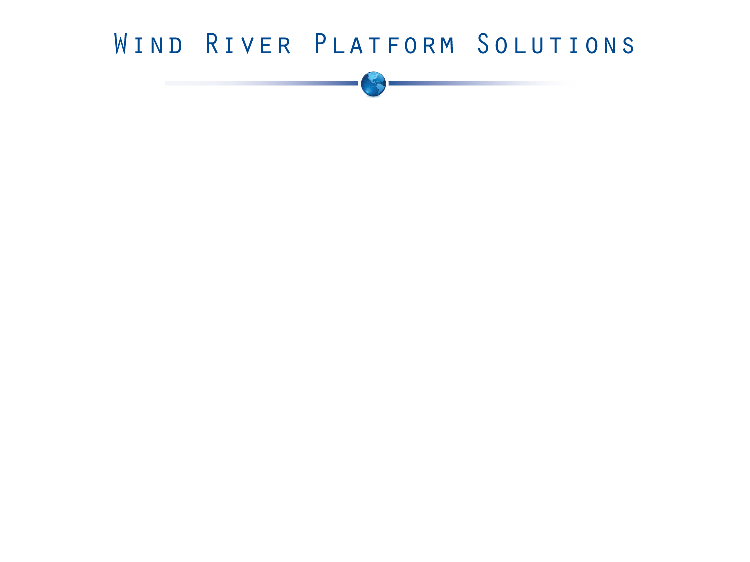
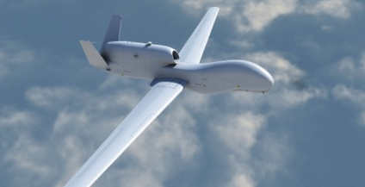
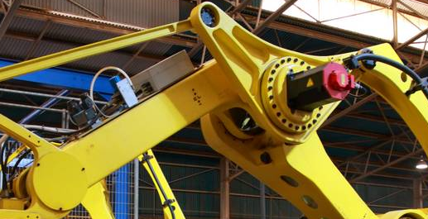


Aerospace and Defense
Industrial and Medical
Network Equipment
Consumer
Wind River Workbench Development Suite and Test Management
Networking, Graphics, Security, and Connectivity Middleware Technologies
Wind River
VxWorks MILS Platform
Wind River
VxWorks 653 Platform
Partner Software Ecosystem
Wind River VxWorks Cert (DO-178B/IEC 61508)
Wind River Services
Wind River VxWorks 6
Wind River Linux
Wind River Linux
Virtualization: Wind River Hypervisor
Optimized Hardware Integration
Wind River Simics
Notes:
3
Discuss the product suite and the strategy, including that multicore and virtualization are horizontal technologies that span our products and the vertical markets we serve.
Benefit:
Choice of both proprietary and open source software operating systems, with a choice of real-time options and leadingedge multicore and virtualization support, with a common Eclipse-based development suite (Wind River Workbench), allowing customers to choose the right device software for their projects
Proof:
Based on industry application, customers can select the right device software from the same vendor—Wind River. They can also use VxWorks and Linux with the same development suite, which is optimized for Wind River OS platforms. Migration from VxWorks to Linux is also easy with Wind River.

Slide 4
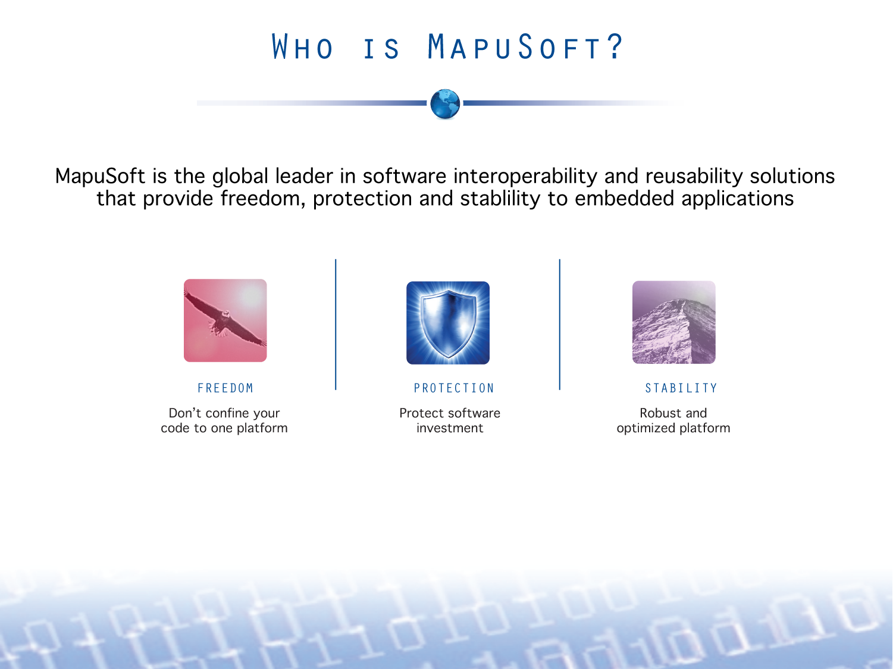

Slide 5
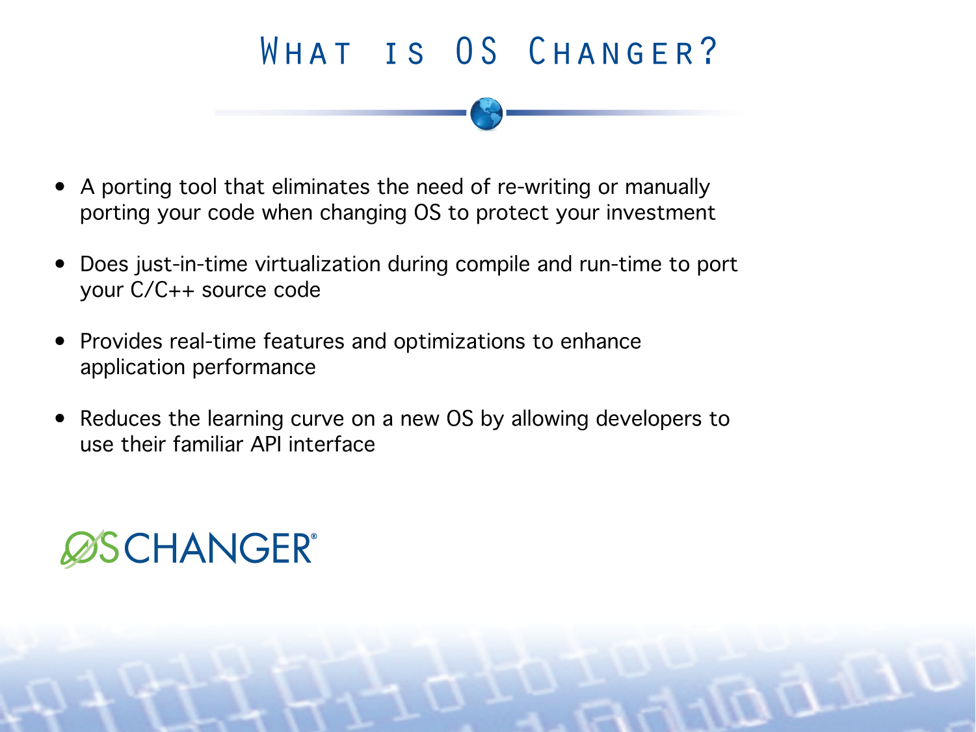

Slide 6
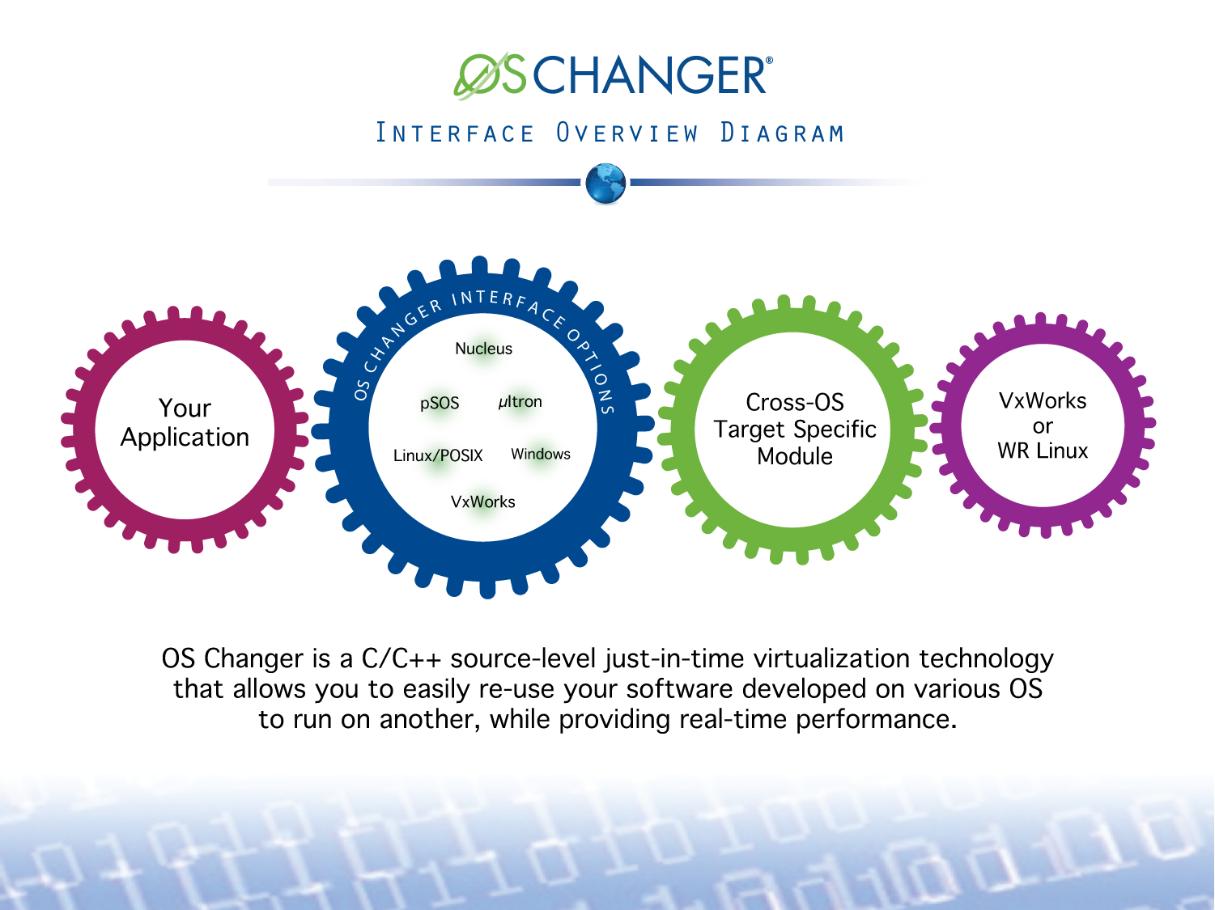

Slide 7
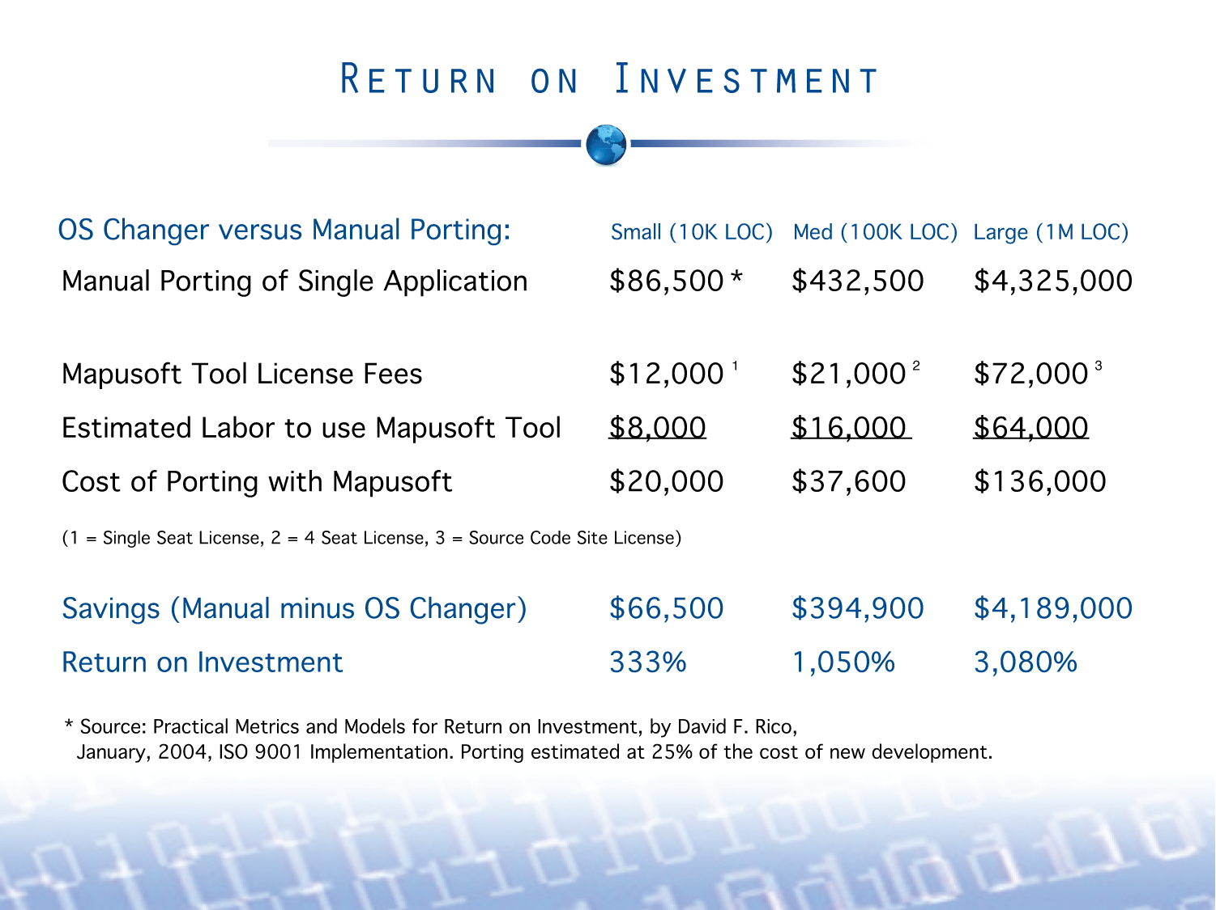

Slide 8
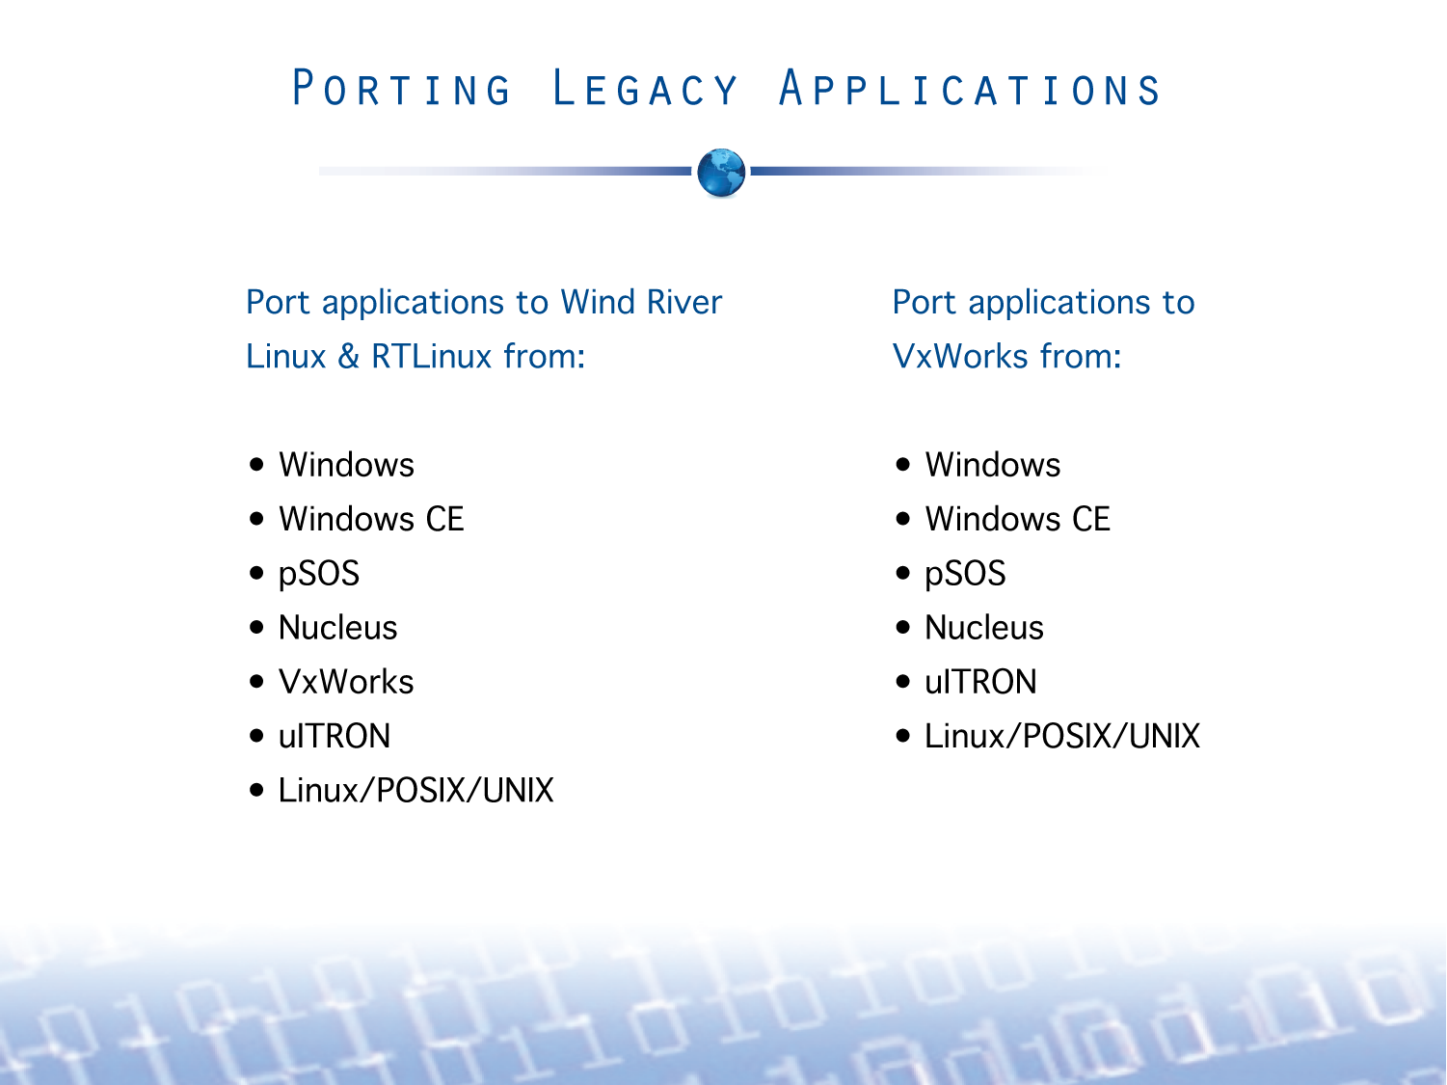
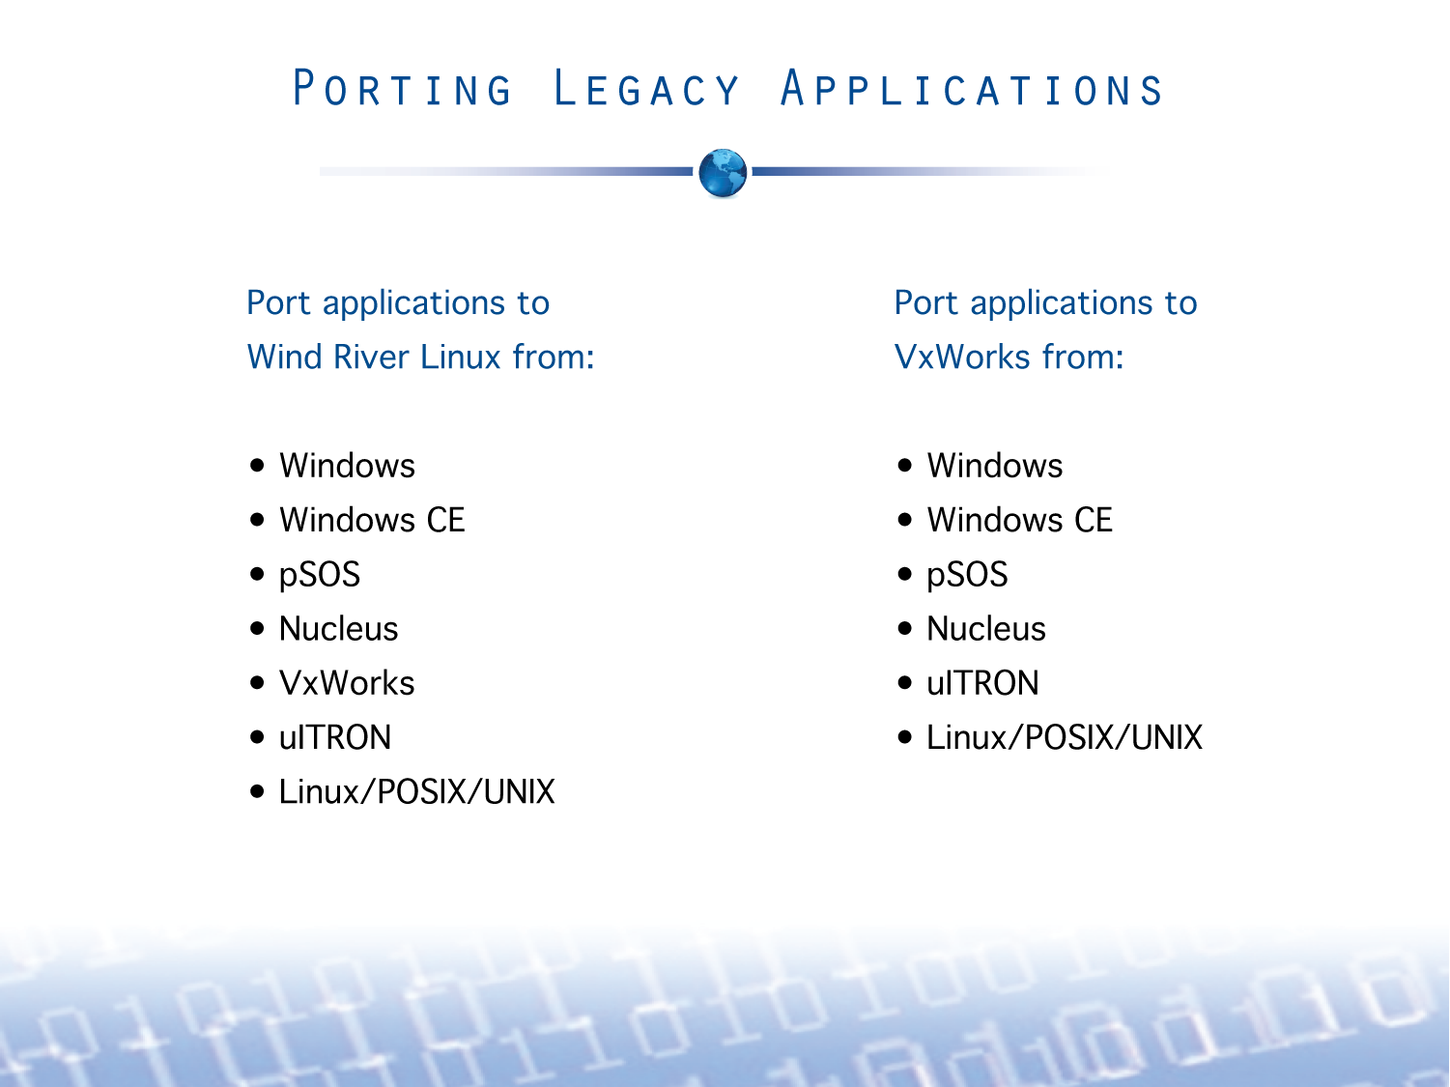
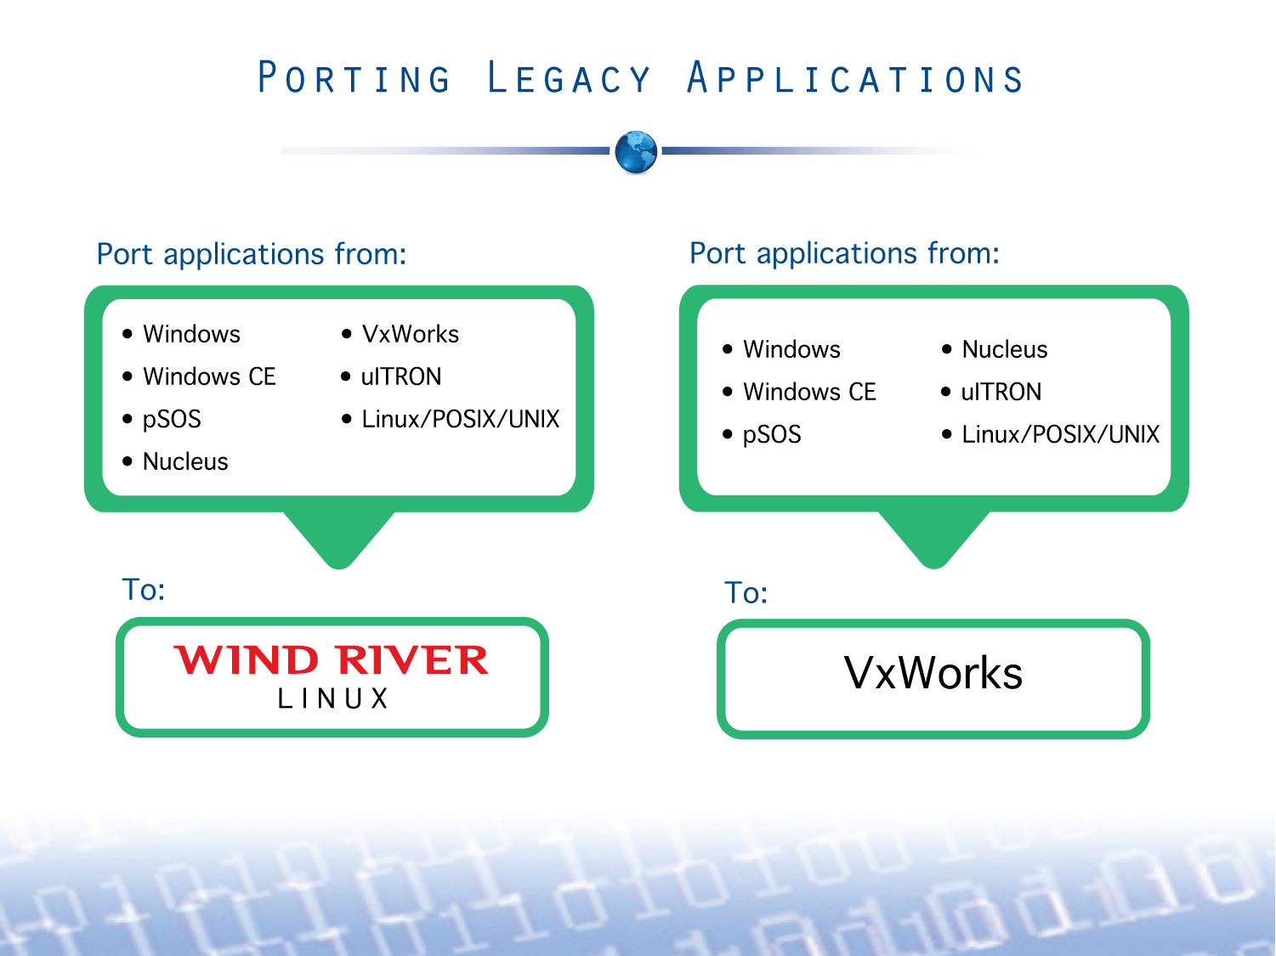

Slide 9
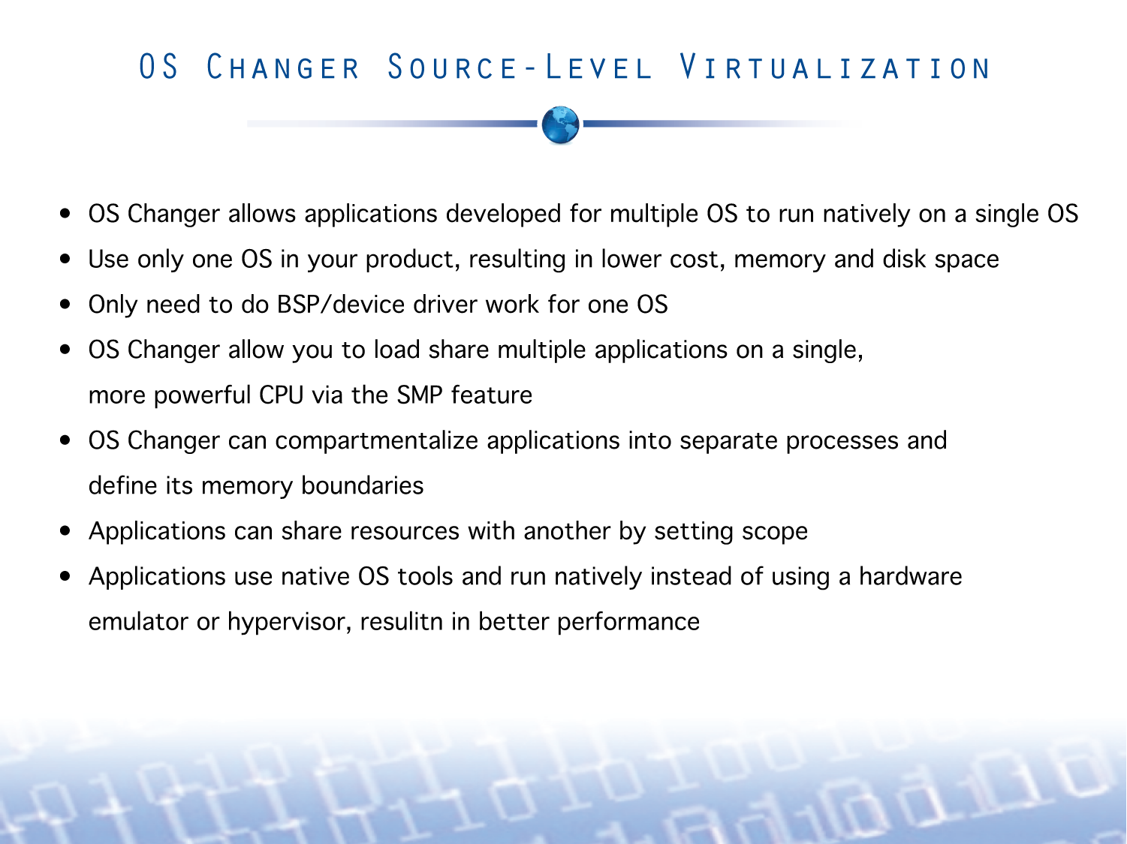
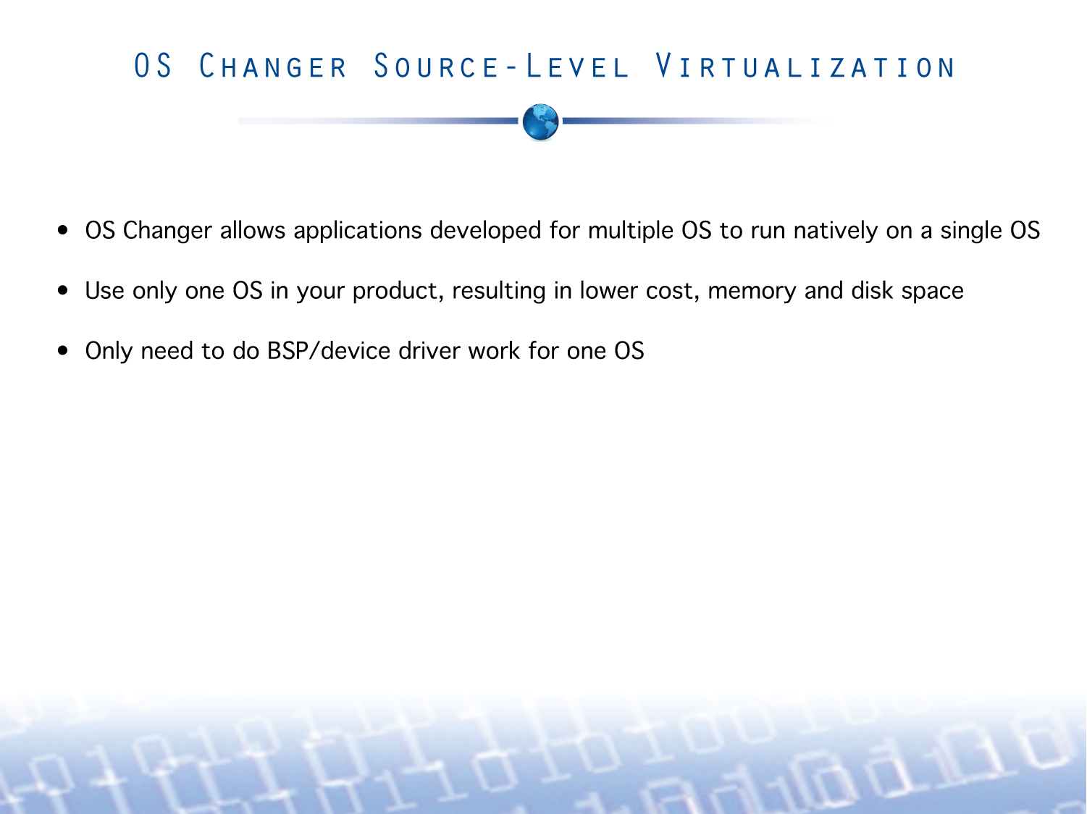
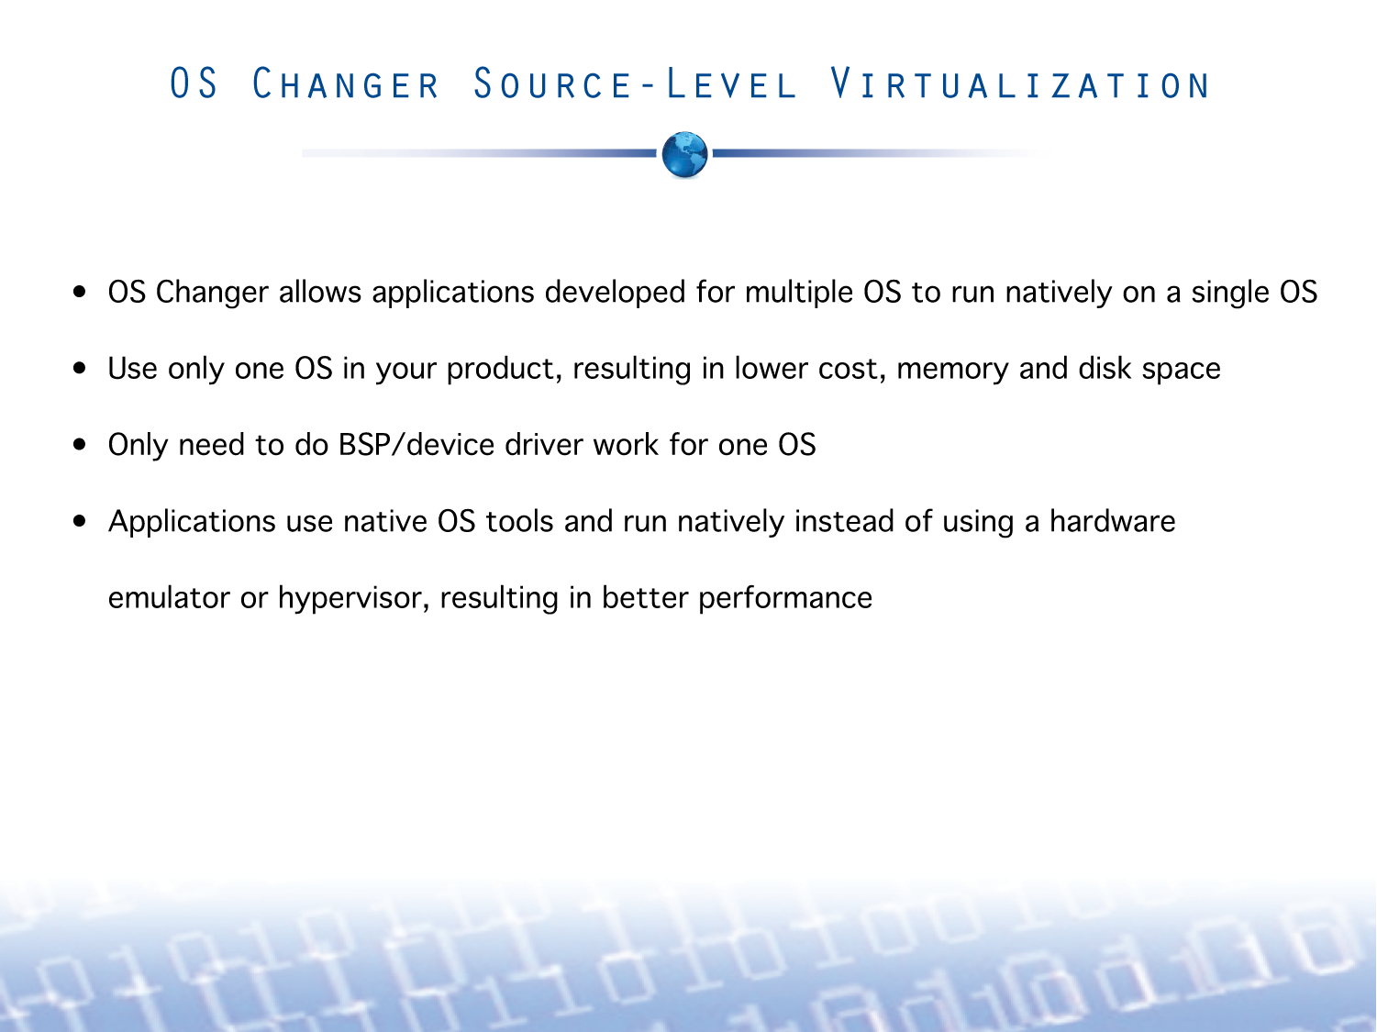

Slide 10
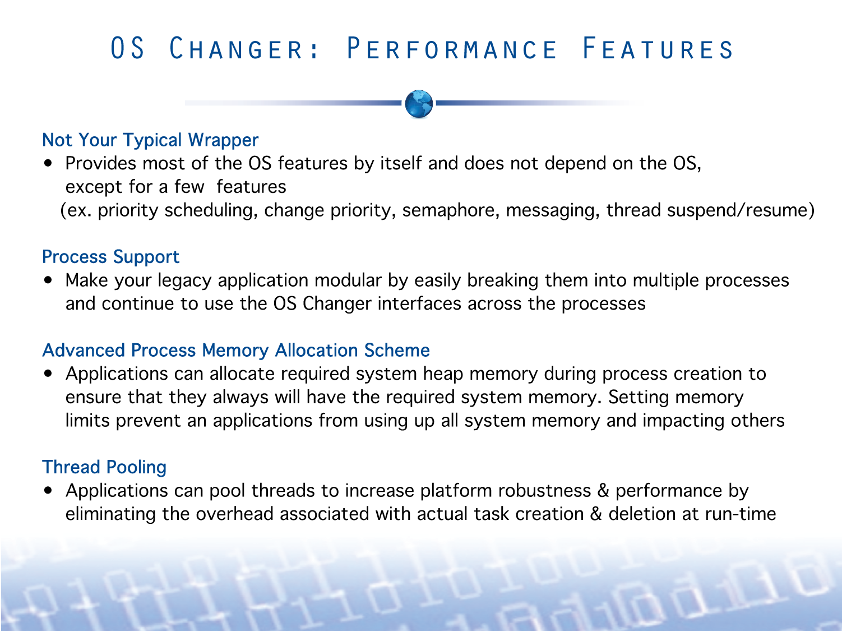
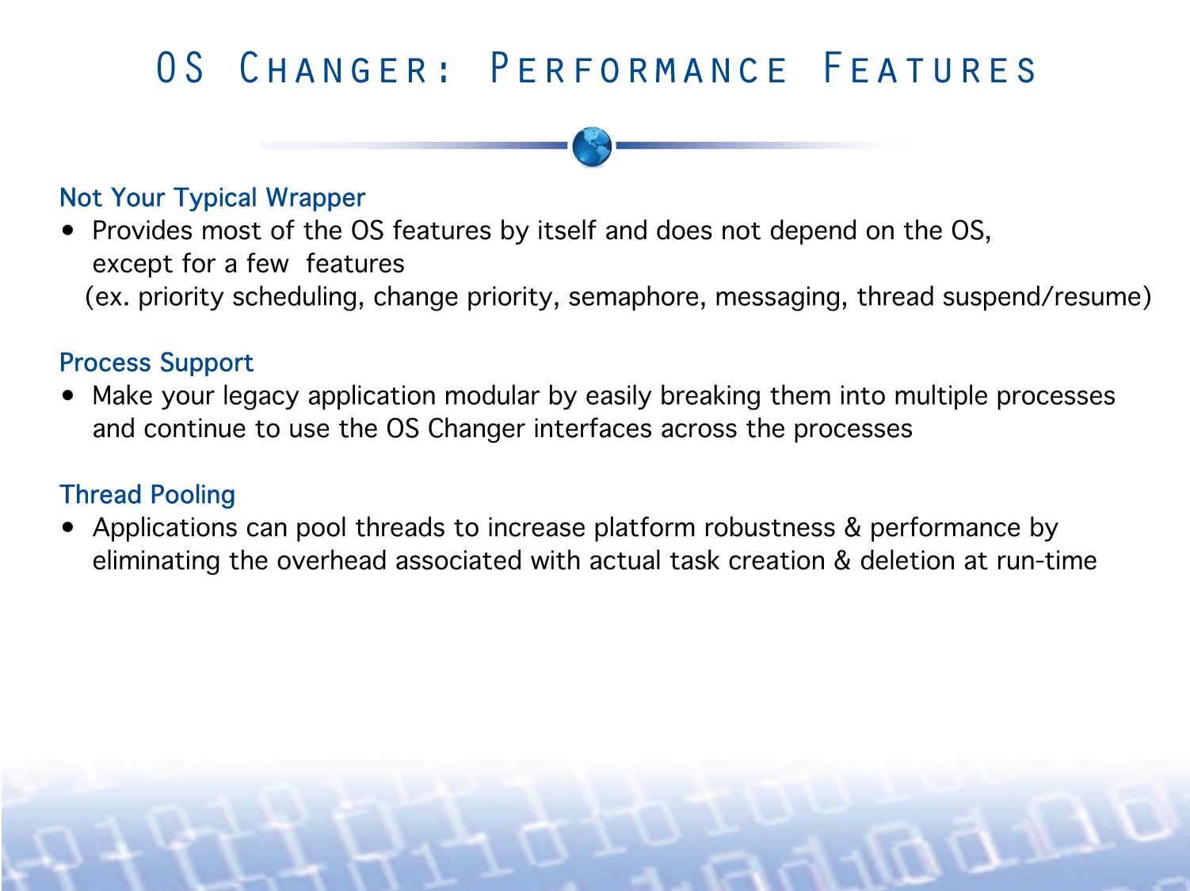

Slide 11
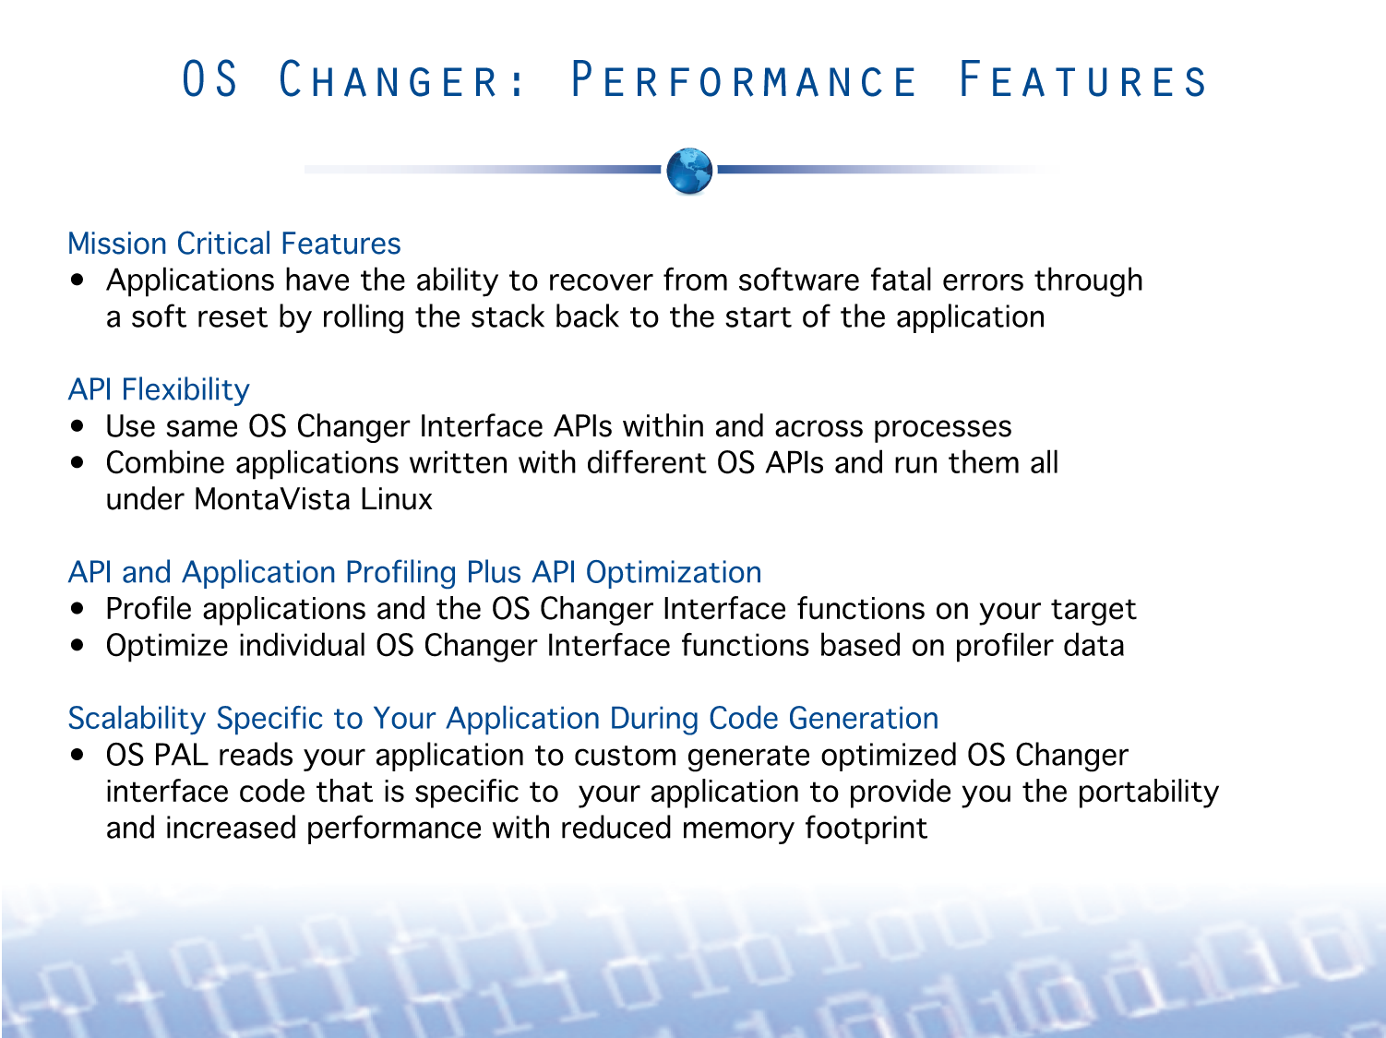
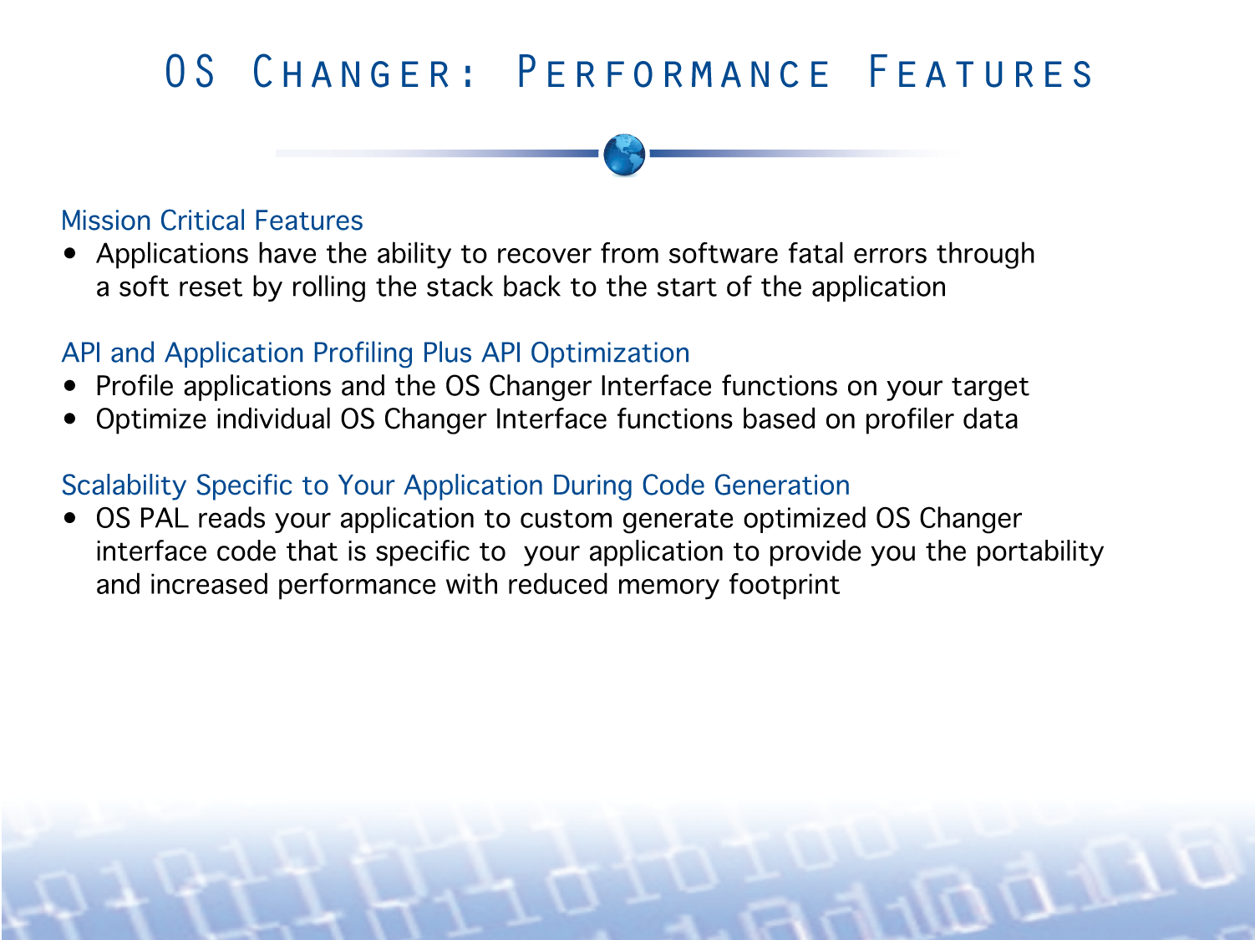

Slide 12
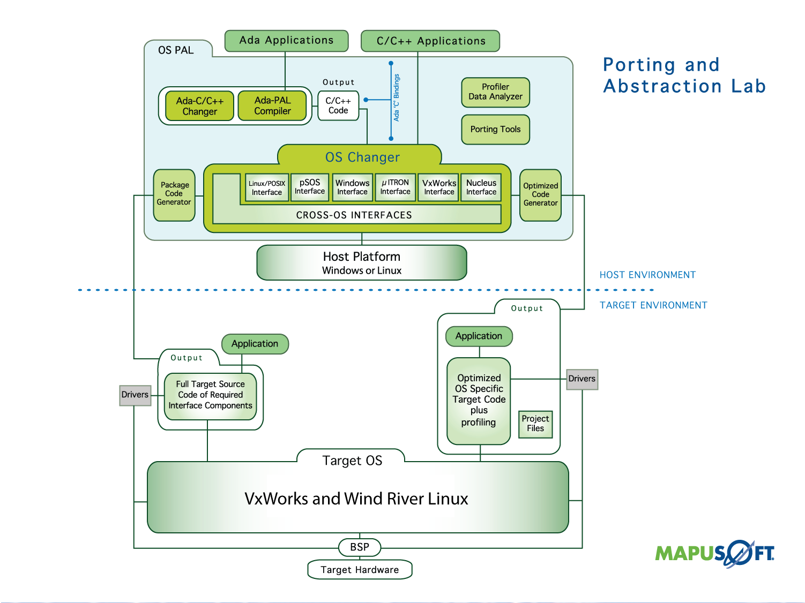
Change to VxWorks & WR Linux

Slide 13
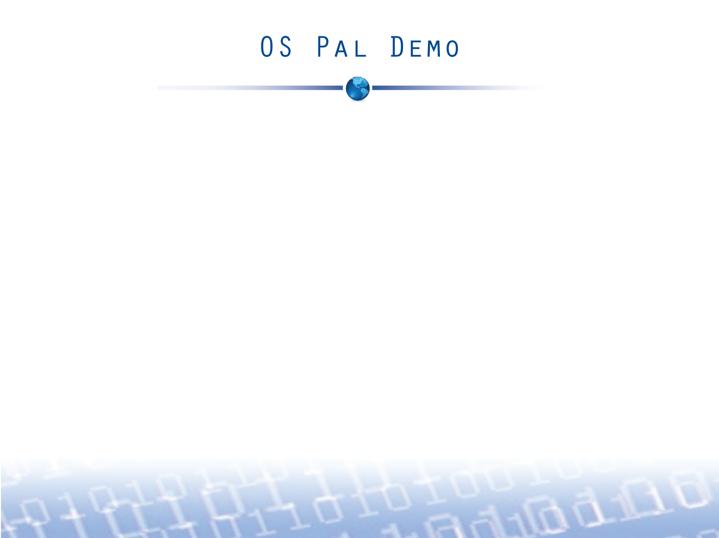
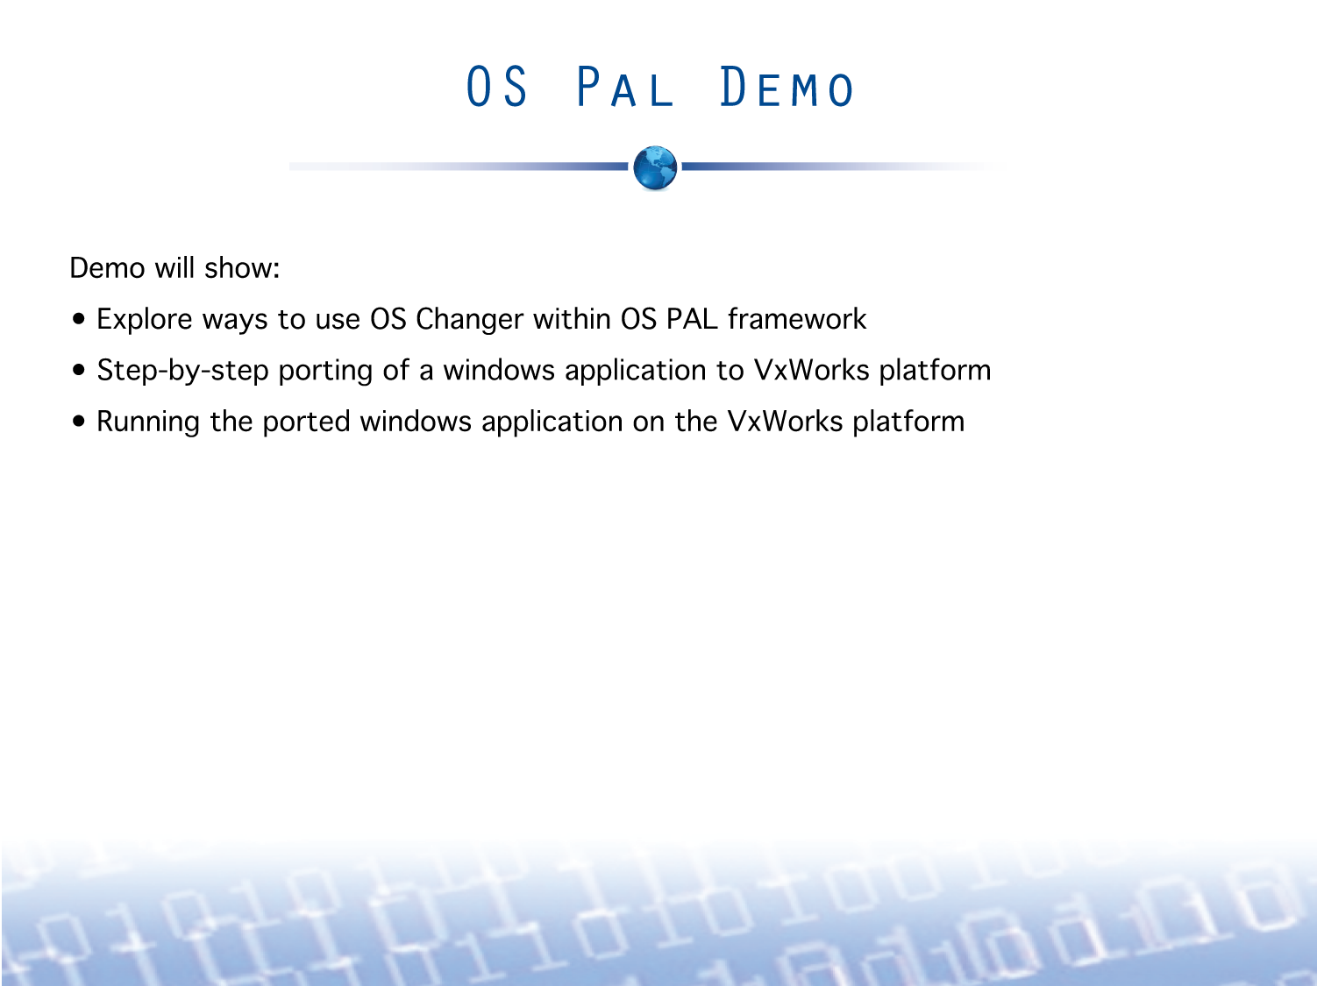
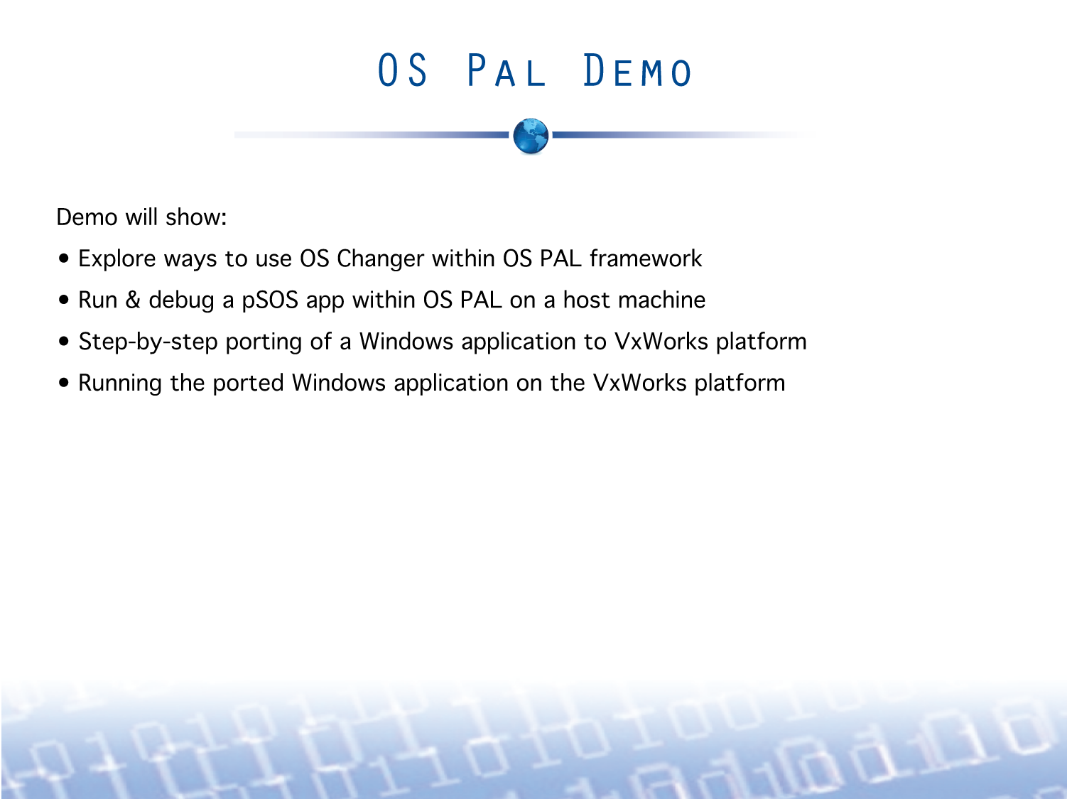

Slide 14
