Slide 1
RTOS SIMULATOR
ACADEMIC Embedded Learning - 2022

Slide 2
MapuSoft’s academic RTOS Simulator is a world class embedded system learning solution that includes leading RTOS platforms at affordable prices.
This tool allows students to quickly learn building industrial applications on various Real-time Operating Systems (RTOS) platforms and acquire key programming skills to advance their careers in the right direction.
RTOS Researchers/Faculties can publish high impact papers by comparing various features of different RTOS in various embedded applications.
2

Slide 3
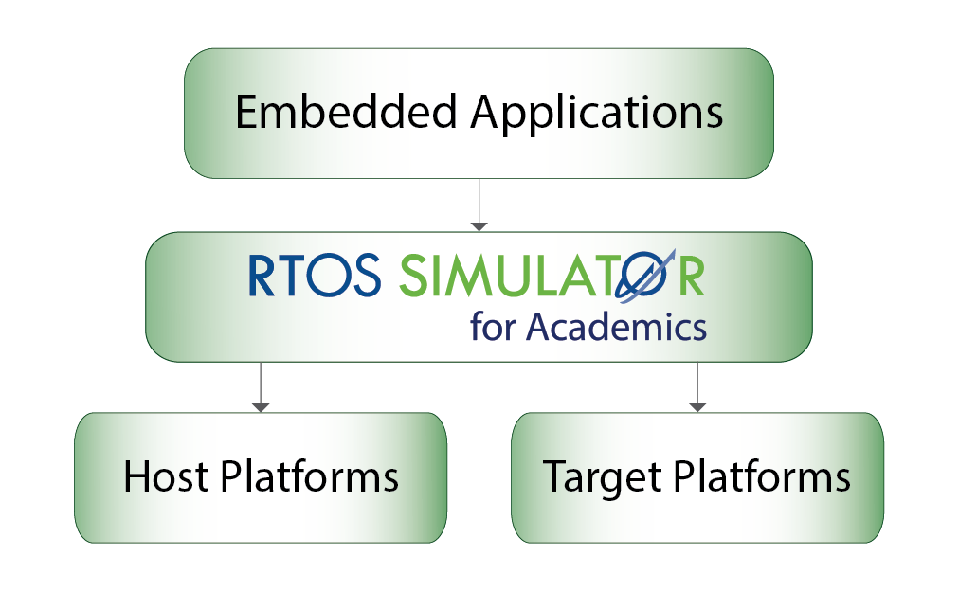
WHY RTOS SIMULATOR?
Job opportunities with higher packages for students by attracting more MNC product companies for campus interviews.
University does not need to invest on expensive embedded tools and hardware to have RTOS based Real-time software R&D lab environments.
Hands-on learning by developing RTOS based applications without the cost of proprietary or expensive software and target hardware.
Research papers can be published by faculties/researchers by comparing performance of various features exhibited by different RTOS.
Companies recruiting RTOS trained students will save their time and money as they can be immediately assigned to real-time projects.
Increase in the campus placement due to improved student’s core technical skills

Slide 4
What is RTOS Simulator?
RTOS Simulator is integrated with AppCOE, an Eclipse-based framework, providing a state-of-the-art IDE for application development, testing and simulation on x86 Windows and Linux host machines
Optionally, libraries can be made available in source format for use with target native tools/software (e.g. Use of RTOS Simulator within Visual C/C++ environment)
Provides a virtualized test platform to simulate a system of applications interacting with each other on one or more CPU cores through simulated devices
RTOS Simulators are available for many popular operating systems: VxWorks, Linux/POSIX, Nucleus, uITRON, pSOS, Windows and ThreadX

Slide 5
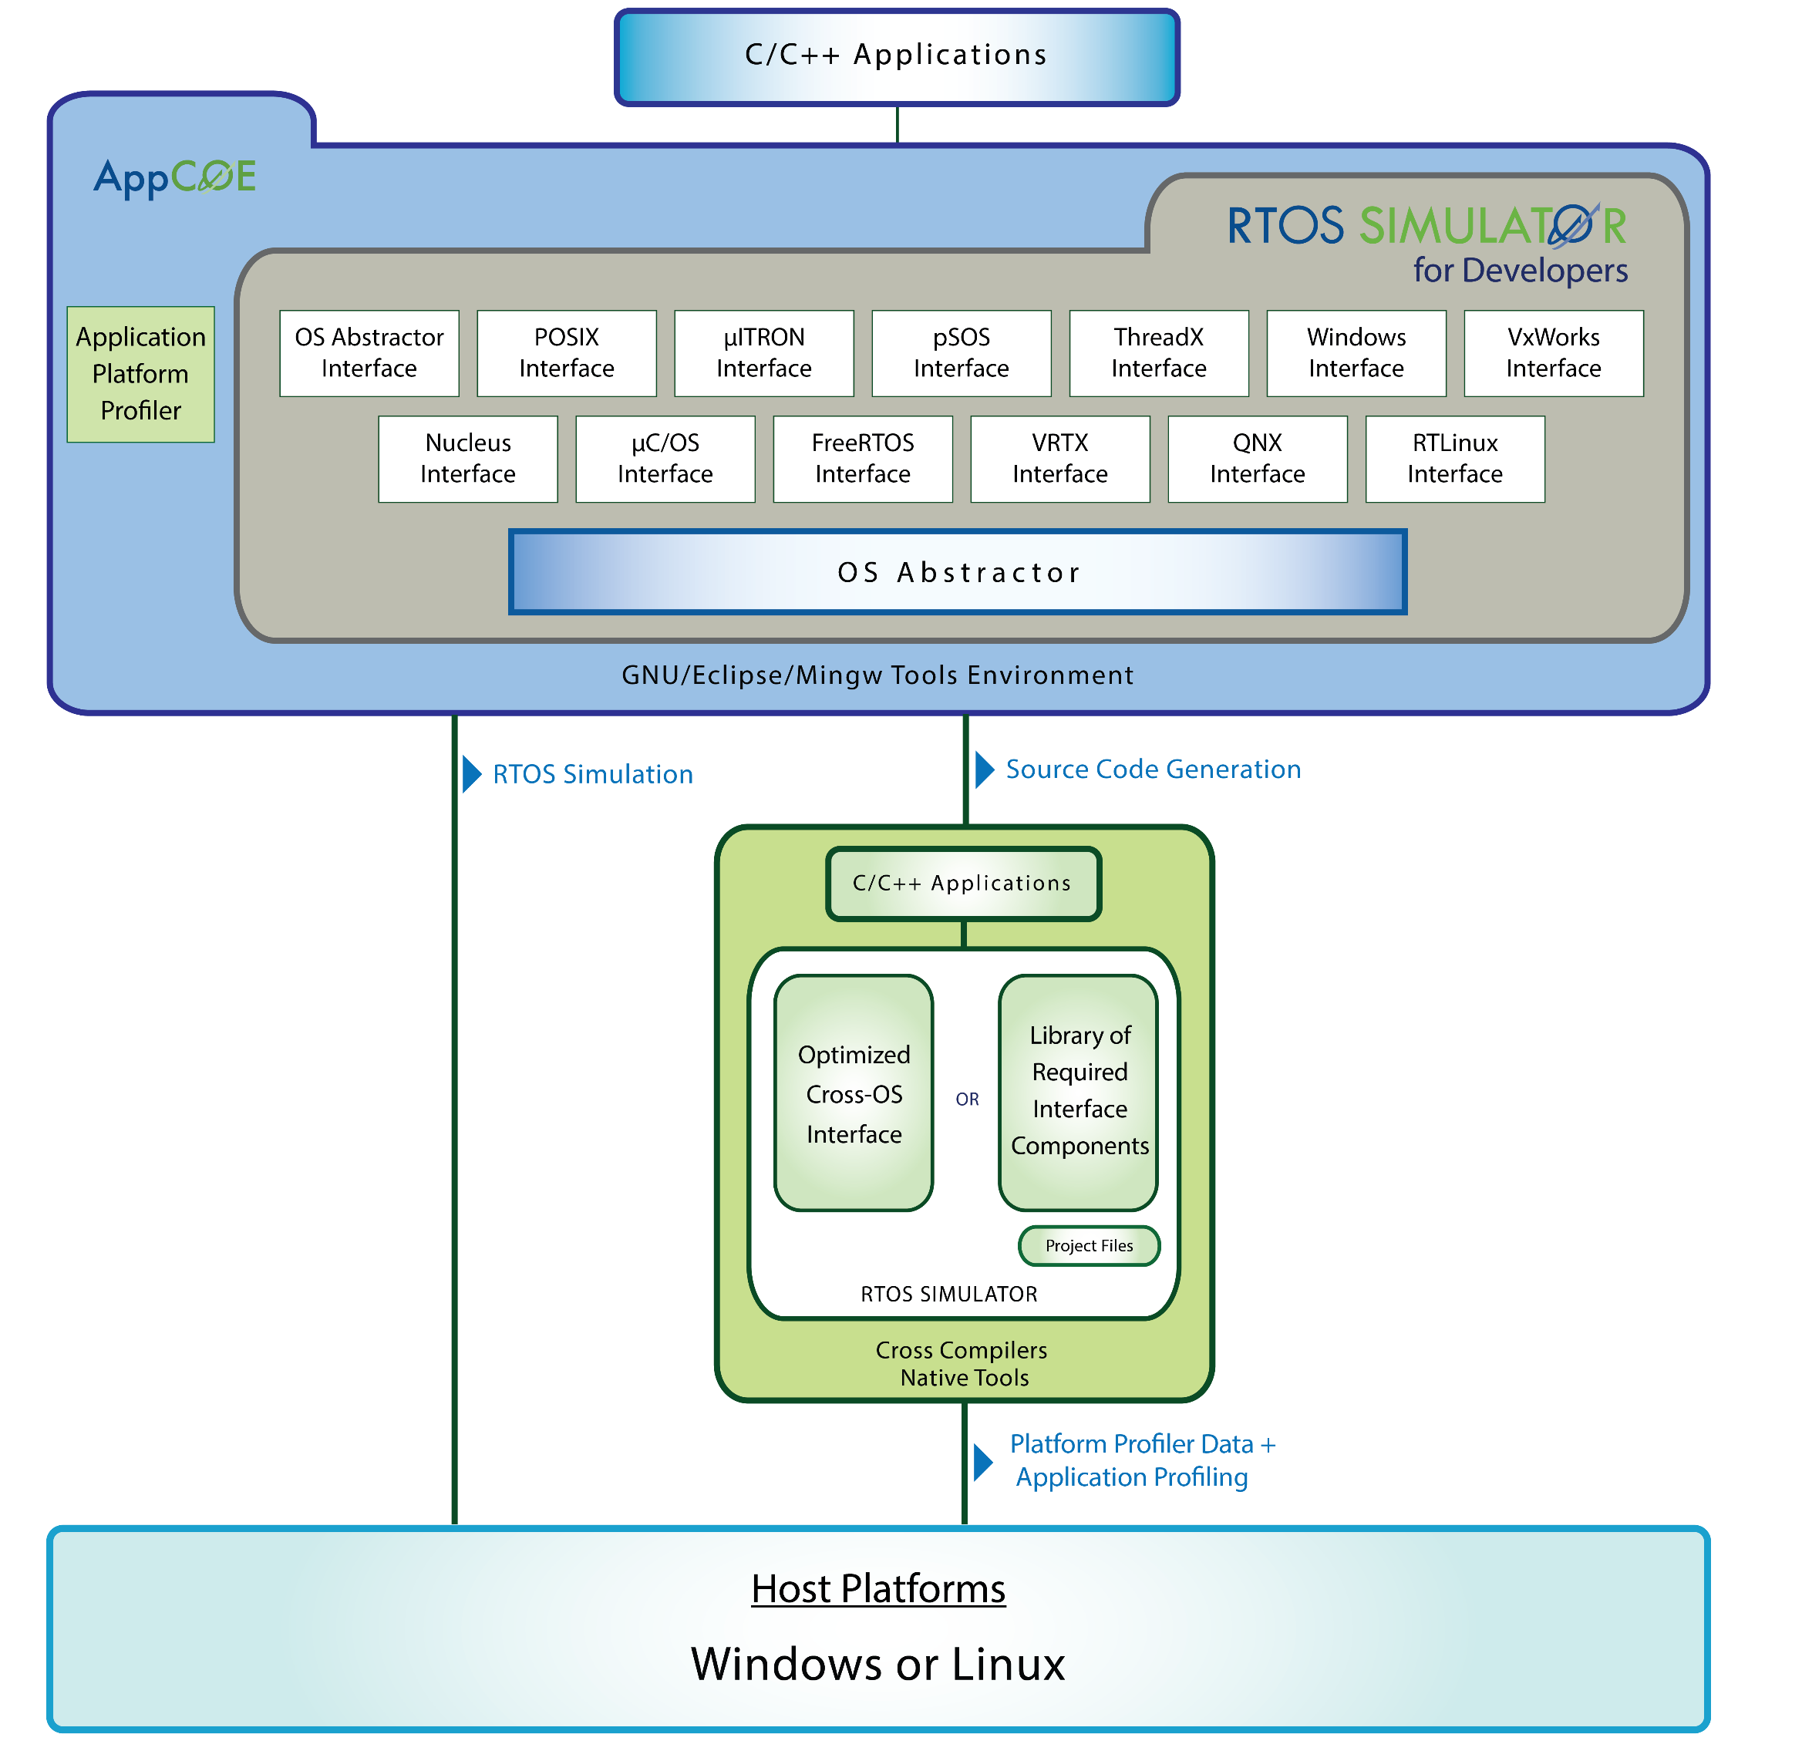
Develop applications on
a virtualized host platform

Slide 6
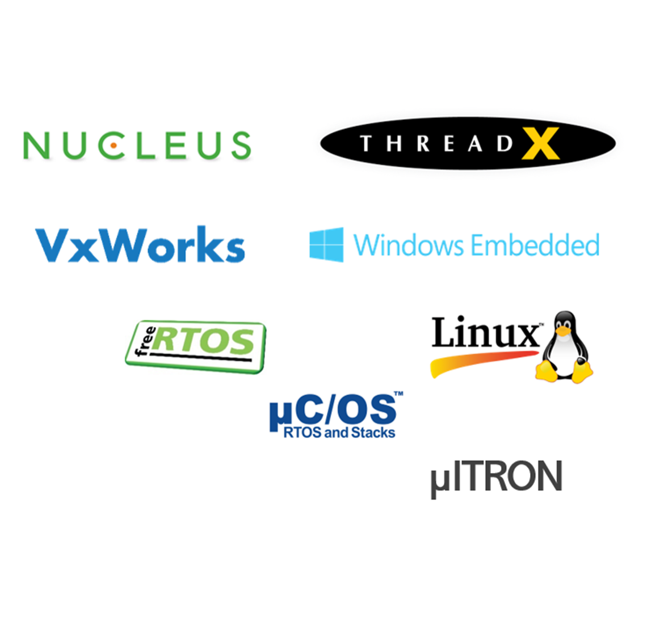
WHY MAPUSOFT’s RTOS SIMULATOR?
Supports many popular commercial & open standards based RTOS Simulation
Our Simulator is compatible with more than 20 different target OS and hence choice of more RTOS platforms.
Install on any versions of windows & Linux host machine/PC and develop application over simulated RTOS.
Based on Eclipse framework, our simulator provides development and testing tools environment using state-of-the-art IDE to develop RTOS application.
Improved technical skills of faculty & students by building code with cross-tools directly for various supported target hardware like RasberyPi, ARM board etc.
Support application development on multi-core and multi-process environment.
Costs only a fraction of industrial prices.
Choice of more RTOS platforms
No need to have additional infrastructure apart from PC in lab
Supports more target hardware types than any other product
Costs only a fraction of industrial prices.
Our Simulator is compatible with more than 20 different target OS

Slide 7
Head-head PRODUCT COMPARISON
Competitor
JUST ONE RTOS User gets locked to one OS vendor
NO TRAINING Training not provided in most cases
HIGHER COST User gets only one RTOS at high cost
LIMITED SUPPORT Big OS vendors may not provide tech support
PARAMETER
VALUE
TRAINING
PRICE
SUPPORT
CHOICE OF 2 OR 4 RTOS User experiences more freedom and flexibility
COMPREHENSIVE PRODUCT TRAINING Onsite training for students and faculty
LOWER COST User gets more RTOS platforms at lower cost
EXTENSIVE SUPPORT Online tech support for longer durations

Slide 8
PRODUCT PRICING
LICENSE | 4 RTOS | 2 RTOS
5 - 10 | INR 99,000 | INR 85,000
11 - 25 | INR 89,000 | INR 75,000
25 - 50 | INR 79,000 | INR 65,000
50 + | INR 75,000 | INR 60,000
Indicated price is for one license seat only
Perpetual node lock license
Covers training and certification
One Raspberry pie board provided
Product support renewable every 2 year
Product support renewal at 20% of list price

Slide 9
FEEDBACK OF Our TOP CUSTOMERS
VIT, INDIA
GEORGIA TECH, USA
WATERLOO UNIV, Canada
NIT CALICUT, INDIA
Our students gained a detailed knowledge of embedded real-time systems and it has given them an edge over other students
MapuSoft’s OS Simulator provides us an excellent platform for teaching embedded operating systems and MapuSoft provided an experienced professional to conduct the on-site training of our staff
We strongly recommend any technical education institute to go for MapuSoft’s OS Simulator as it is ideal for educational institutions allowing students to gain experience working on various popular operating systems
MapuSoft’s software re-use tools protects our software investment and helps us develop rapid product prototypes used to pursue funding from commercial and government sectors

Slide 10
Market segment of some MAPUSOFT’s Customers
Market Segments | MapuSoft Flagship Customer
Automotive
Medical
Telecom & Networking
Industrial
Defense & Mil-Aero

Slide 11
thank you
email
Phone

